Slide 1
Performance Evaluation of Off-grid Mesh Network Communication Using goTenna Pro X and Meshtastic
Final Presentation
Team: GO duck
Gwangyeok Kim, Keonwoo Lim, Sujee Noh, Yeonguk Maeng

Slide 2
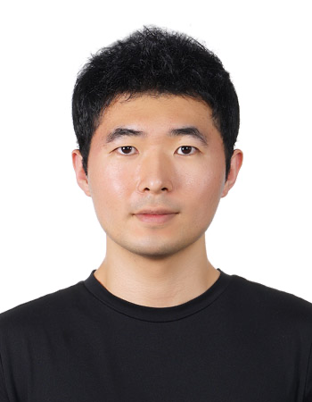
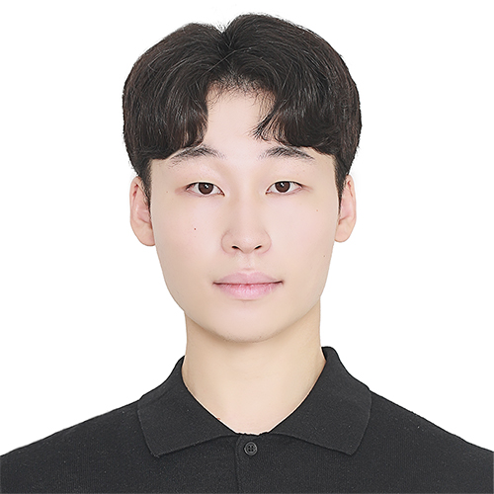
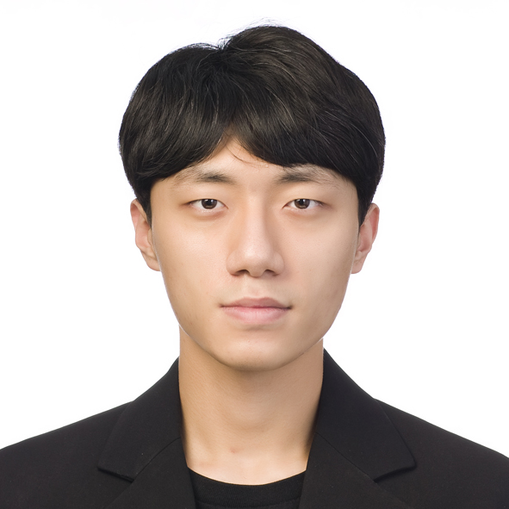
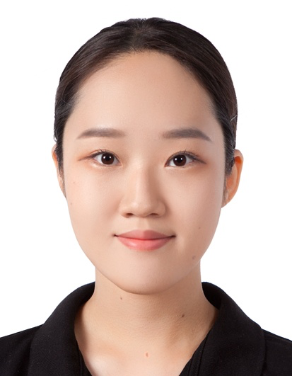


Team Members
Gwangyeok Kim (Leader)
Keonwoo Lim
Younguk Maeng
Sujee Noh
Xavier Lopez
Baylasan Al Shubbar

Slide 3
Summary
01

Slide 4
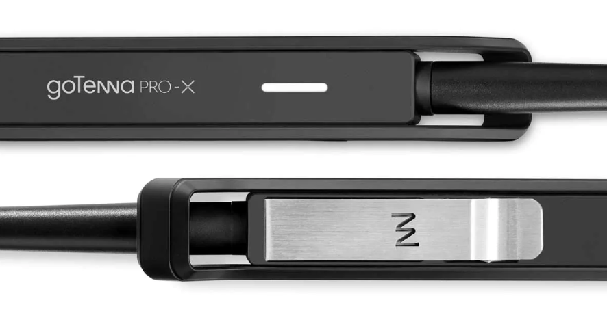
goTenna Pro X
_{[2]}
What is goTenna?
A long-range, lightweight device for mobile mesh networking.^{[1]}
Pairs with a smartphone, and enables simple message communication in an environment without cell or WiFi.
Proprietary
Networking protocol: Aspen Grove
[1] R. Ramanathan, C. Servaes, W. Ramanathan, A. Dusia and A. S. Sethi, "Long-Range Short-Burst Mobile Mesh Networking: Architecture and Evaluation," in \emph{Proc. 2019 16th Annu. IEEE Int. Conf. on Sensing, Commun., and Netw. (SECON)}, Boston, MA, USA, 2019, pp. 1-2, doi: 10.1109/SAHCN.2019.8824803.
[2] goTenna, “gotennaprox_comp2_640x.jpg,” Accessed: Jan. 29 2023 [Online]. Available: https://cdn.shopify.com/s/files/1/0046/7524/0005/products/gotennaprox_comp2_640x.jpg?v=1611262676
Notes:
This technology, known as Aspen Grove™, allows for long-range, short-burst mobile mesh networking through a unique approach that uses no control-packets to achieve optimal network efficiency
it broadcasts information and creates a decentralized mesh network, allowing users to send texts and share locations in a group chats and private messages using an app on their device

Slide 5
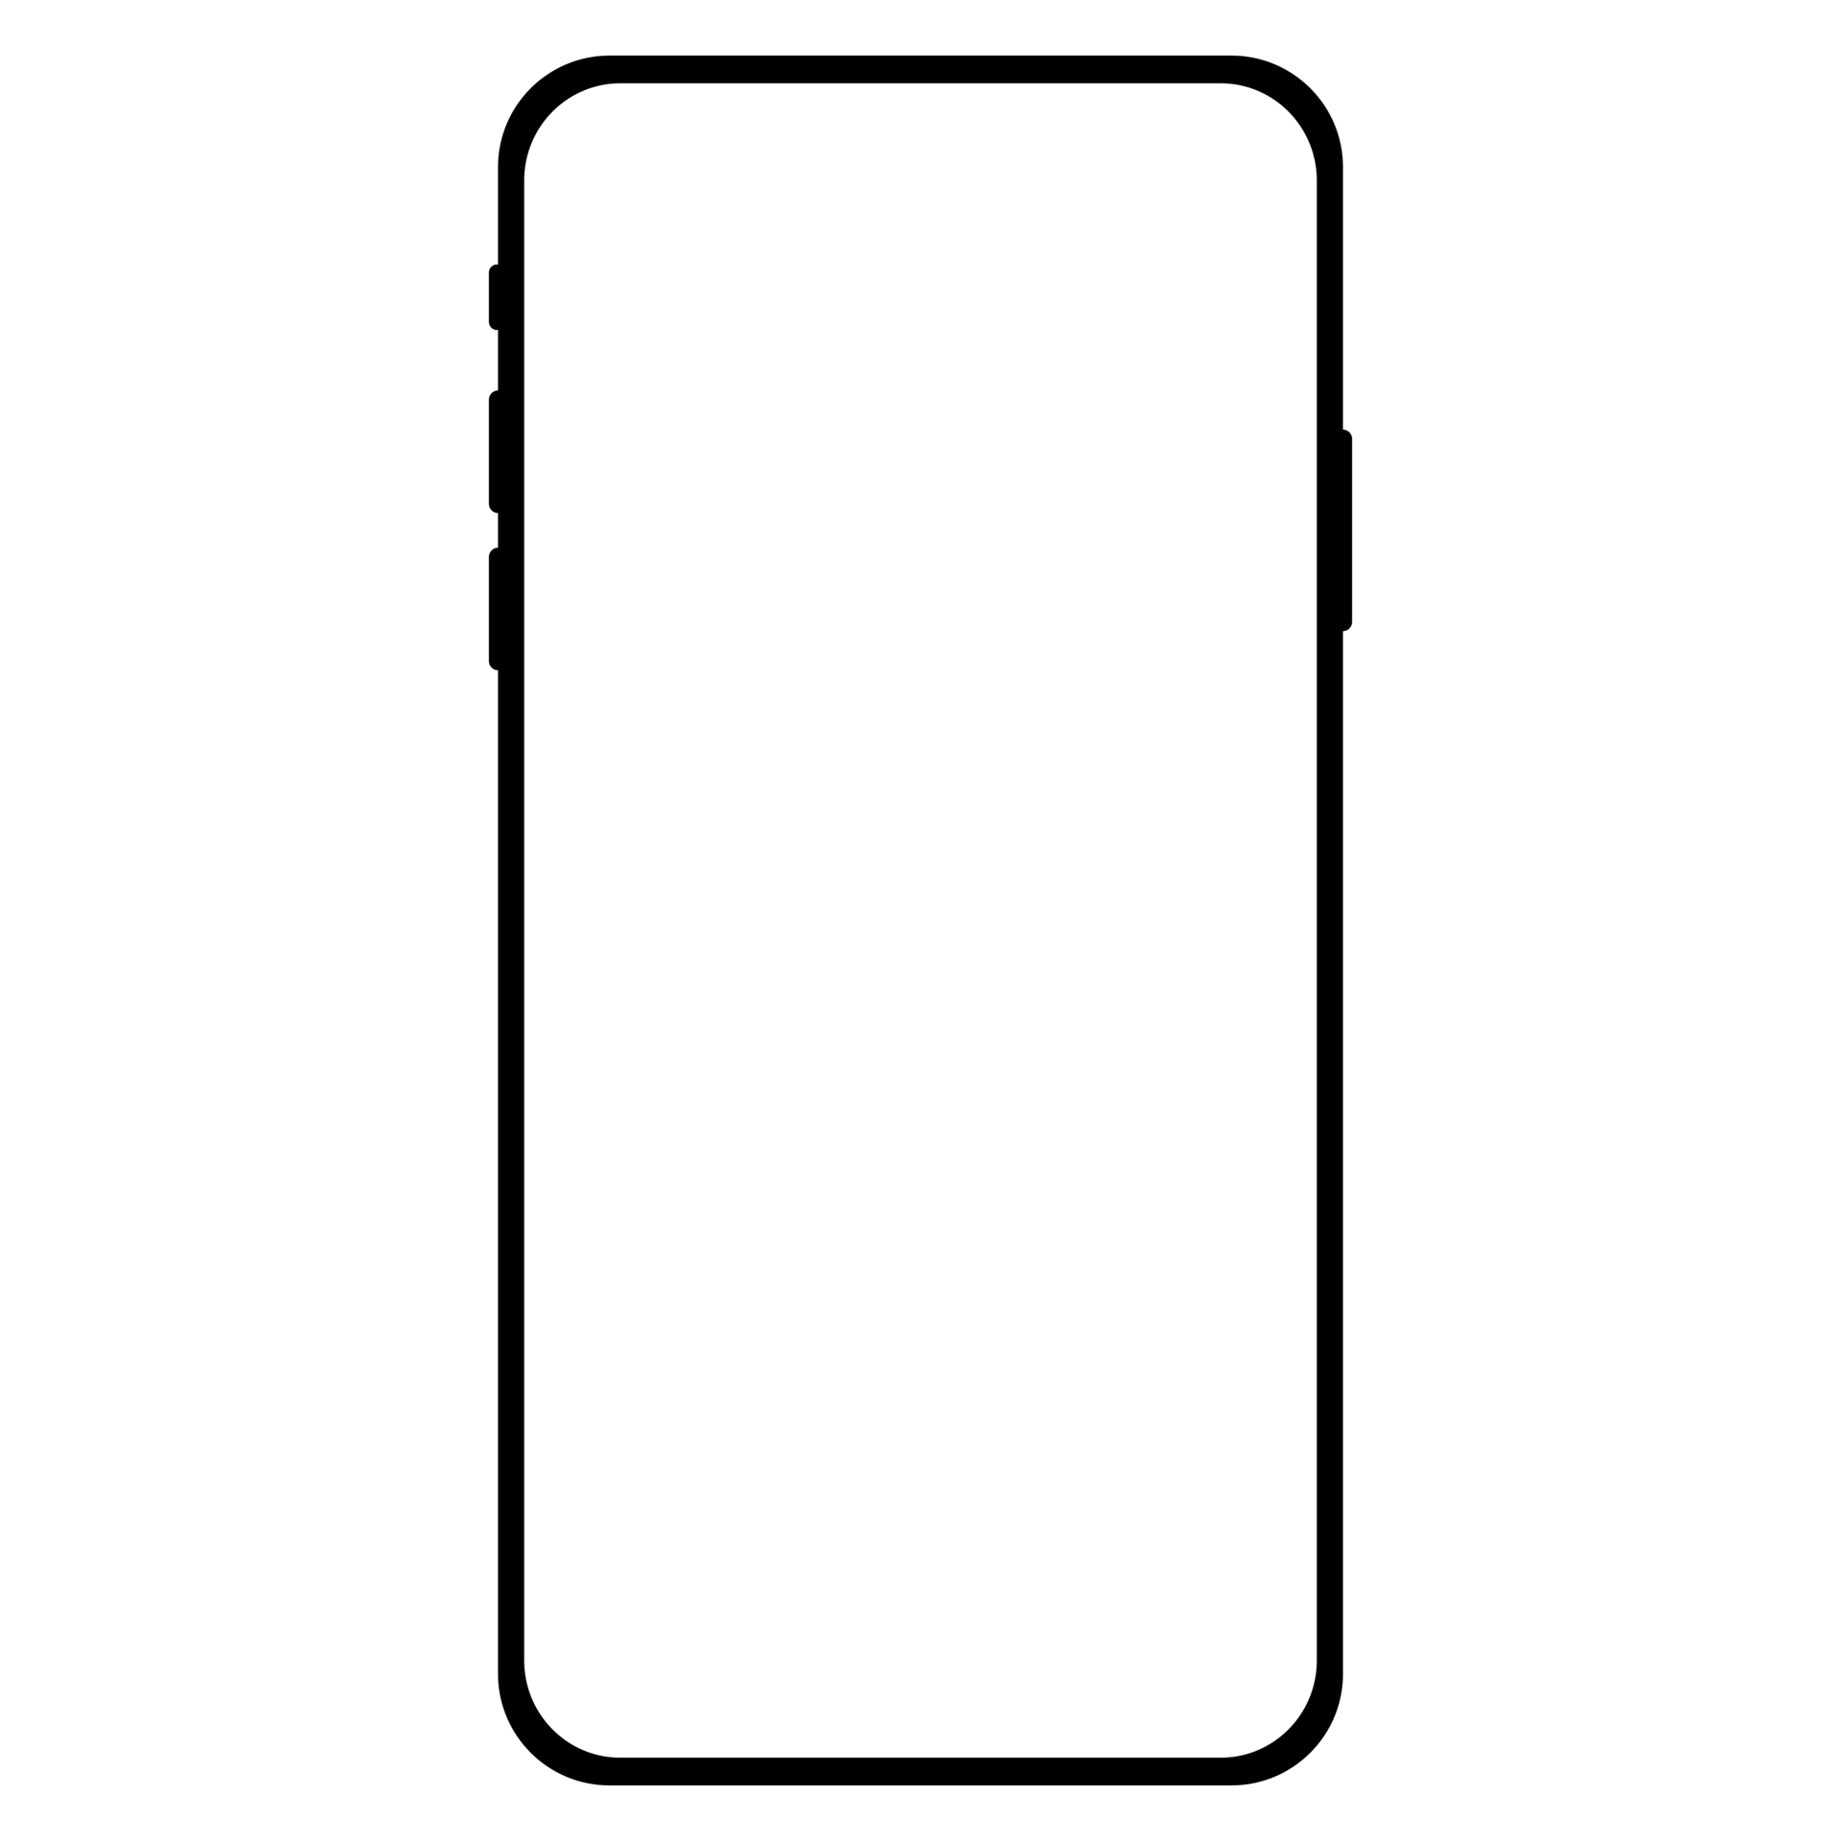
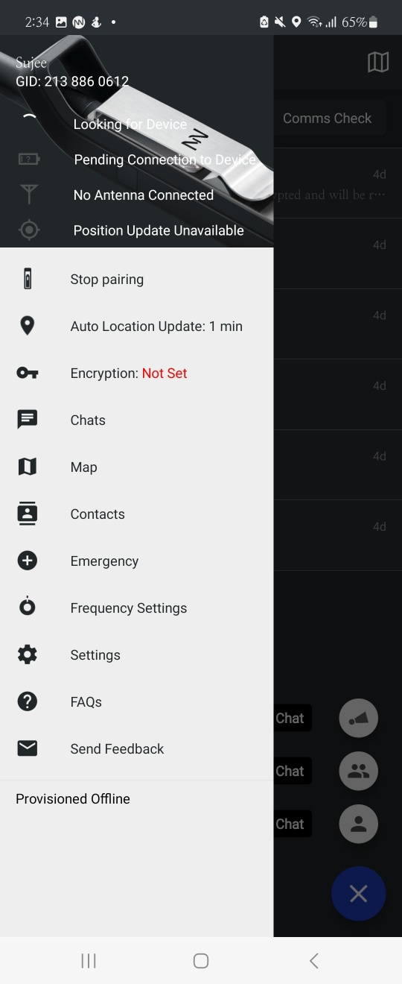
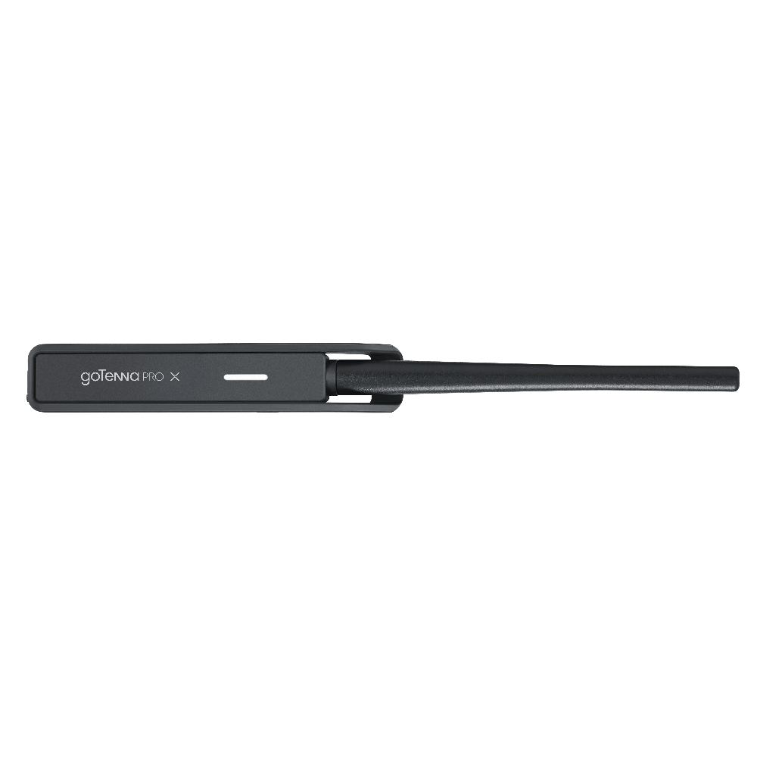
goTenna Pro X- Topology
_{[3]}
_{[3]}
goTenna Pro
Application
goTenna Pro
Application
BlueTooth
BlueTooth
ASPEN GROVE
MESH SUITE
ASPEN GROVE
MESH SUITE
_{[4]}
Hardware
AspenGrove?
-Long-range, short-burst mobile mesh networking through a unique approach that uses zero control-packets
-Broadcasts information and creates a decentralized mesh network
_{[4]}
Hardware
[4] tssi, “GoTennaProX-33_Blk.png,” Accessed: Jan. 29 2023 [Online]. Available: https://images.squarespace-cdn.com/content/v1/56b354e9b09f950655e35066/1588612917921-8ZKPQ5GYLJ3QCELNS18W/GoTennaProX-33_Blk.png

Slide 6

Meshtastic
_{[5]}
_{[3]}
What is Meshtastic?
Off-grid messaging using cost-effective hardware to create your personal mesh^{[5]}
Using their own “Mesh Broadcast Algorithm”
AES256 encryption
Long Battery Life
Community driven, open source project:, allows for wider compatibility for their emergency mesh radio system
Networking protocol: based on Radiohead library
[5] Meshtastic, “Introduction,” Accessed: Jan. 29 2023 [Online]. Available: https://meshtastic.org/docs/introduction
[3] vecteezy, “smartphone-and-mobile-phone-free-png.png,” Accessed: Jan. 29 2023 [Online]. Available: https://static.vecteezy.com/system/resources/previews/011/047/536/original/smartphone-and-mobile-phone-free-png.png

Slide 7
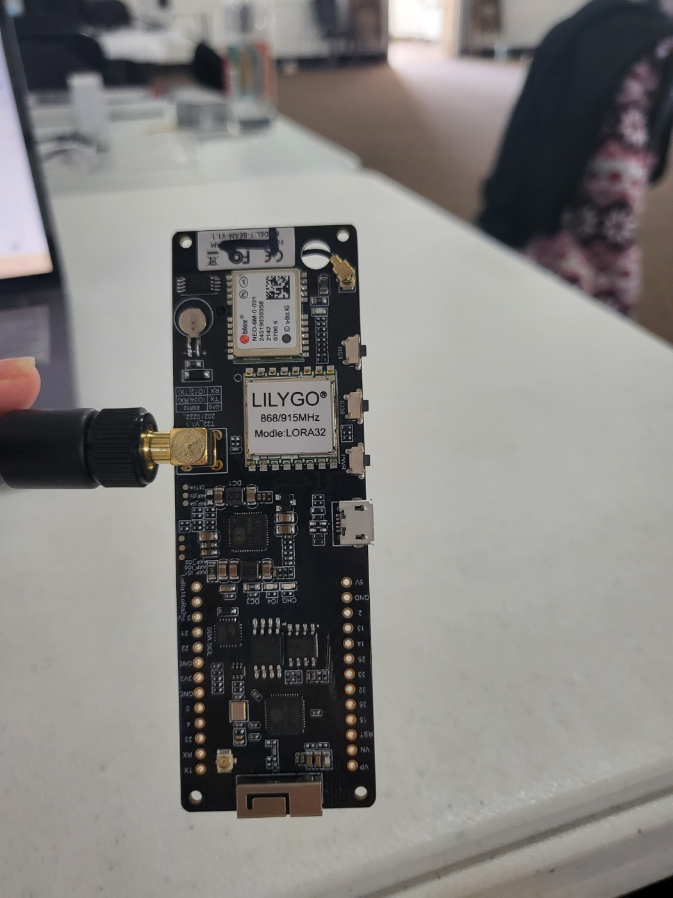
Meshtastic - Topology
_{[3]}
_{[5]}
_{[3]}
_{[5]}
Meshtastic
Application
Meshtastic
Application
BlueTooth
BlueTooth
Mesh
Broadcast
Algorithm
Mesh
Broadcast
Algorithm
LoRa
LoRa
Hardware
Hardware

Slide 8
Summary
It is important to compare how well each device can act as an external antenna in disaster situations with no cell phone service when the infrastructure is down.
 | goTenna Pro X | Meshtastic T-Beam
Price | $900 | $50
Frequency Band | UHF (474 ~ 474.375 MHz) | 915 MHz (US)
Power | 5 W | 100 mW
Antenna Gain | 5.15 dBi | 5 dBi
License | Proprietary | Open-Source
Connectivity | Bluetooth | Bluetooth, WIFI, Serial
Notes:
9:32 80
16:24 26
16:55 24%
10:00 84%
16:44 17%
16:56 16%

Slide 9
Device Setup
02

Slide 10
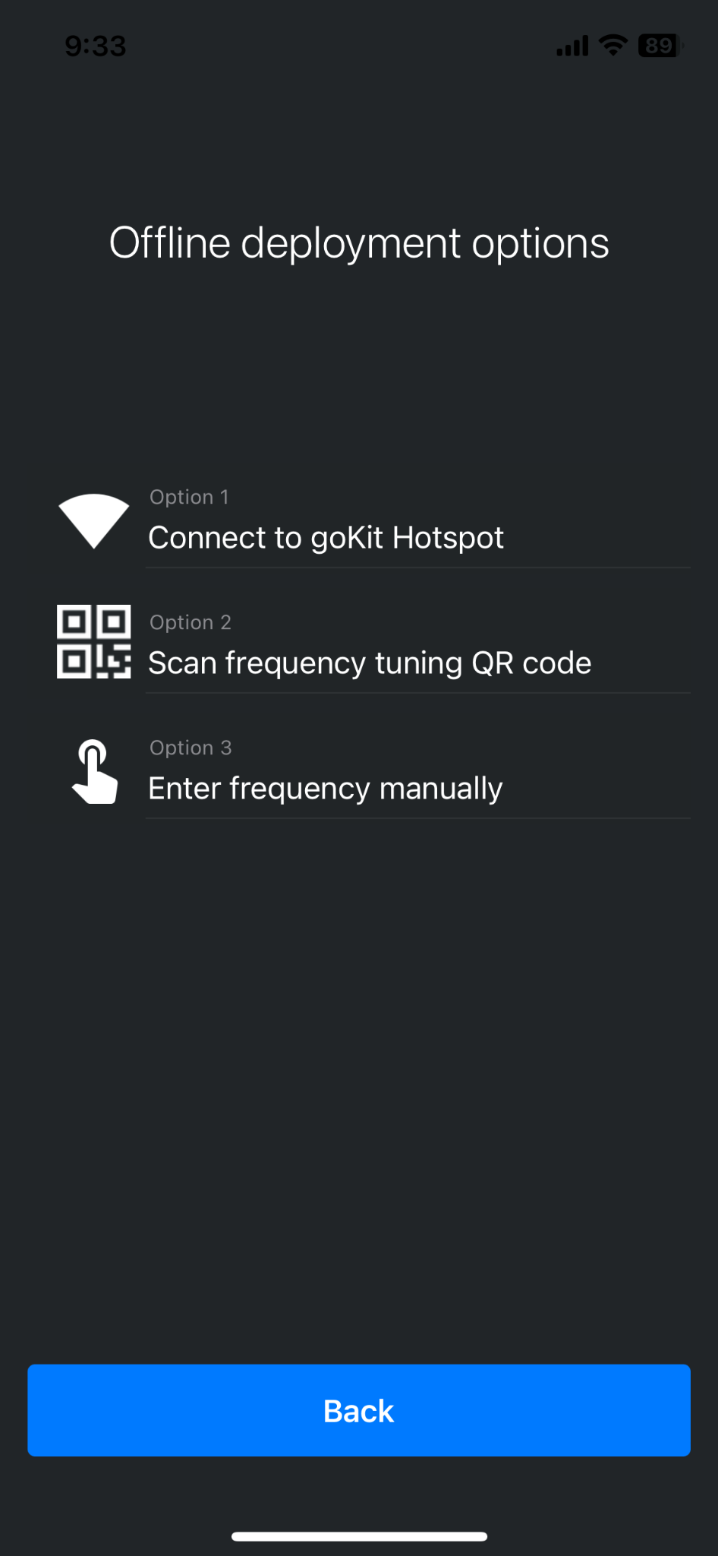
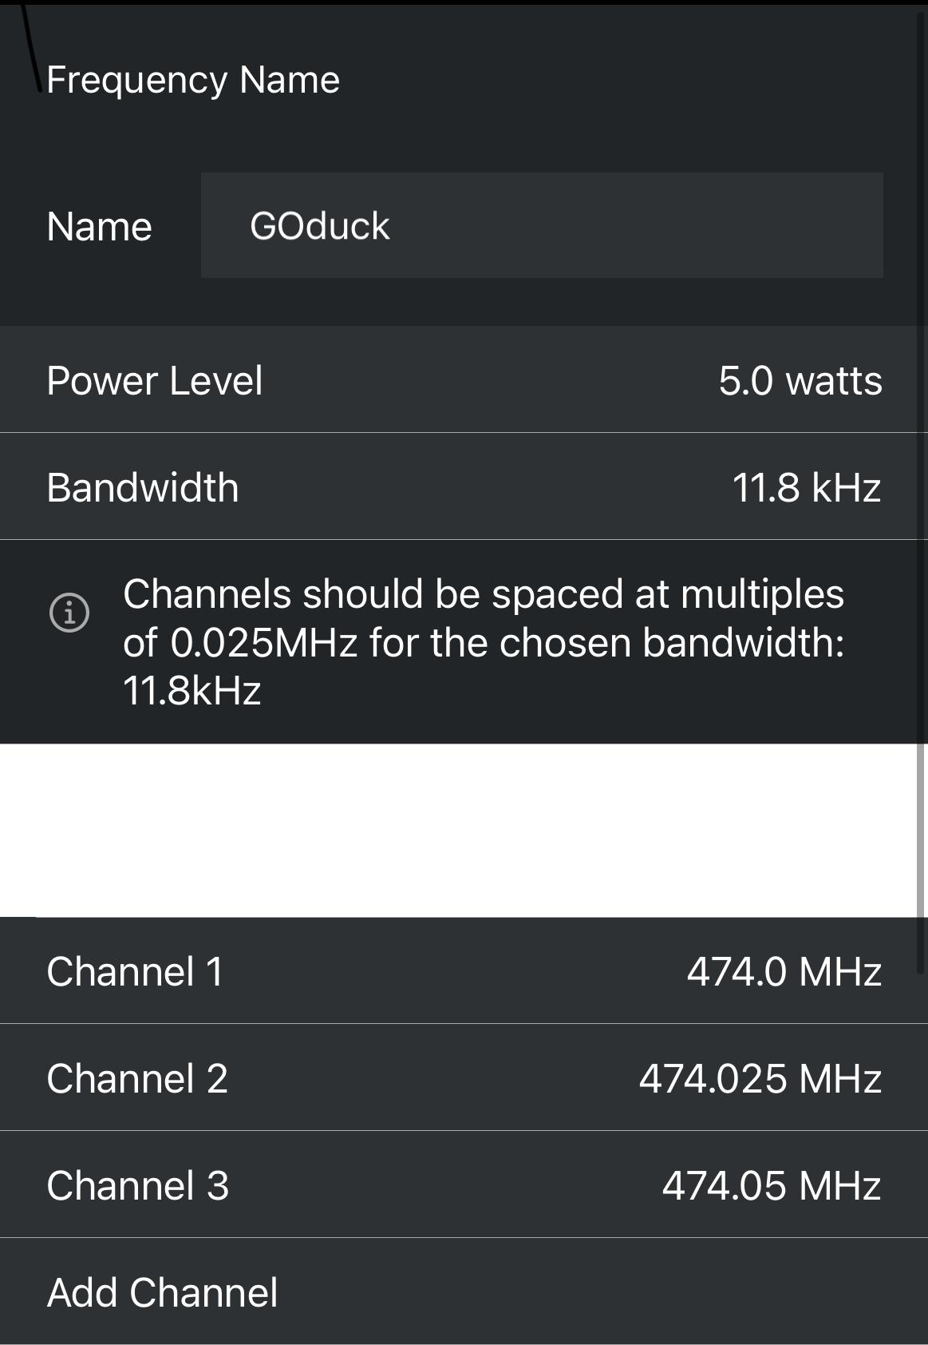
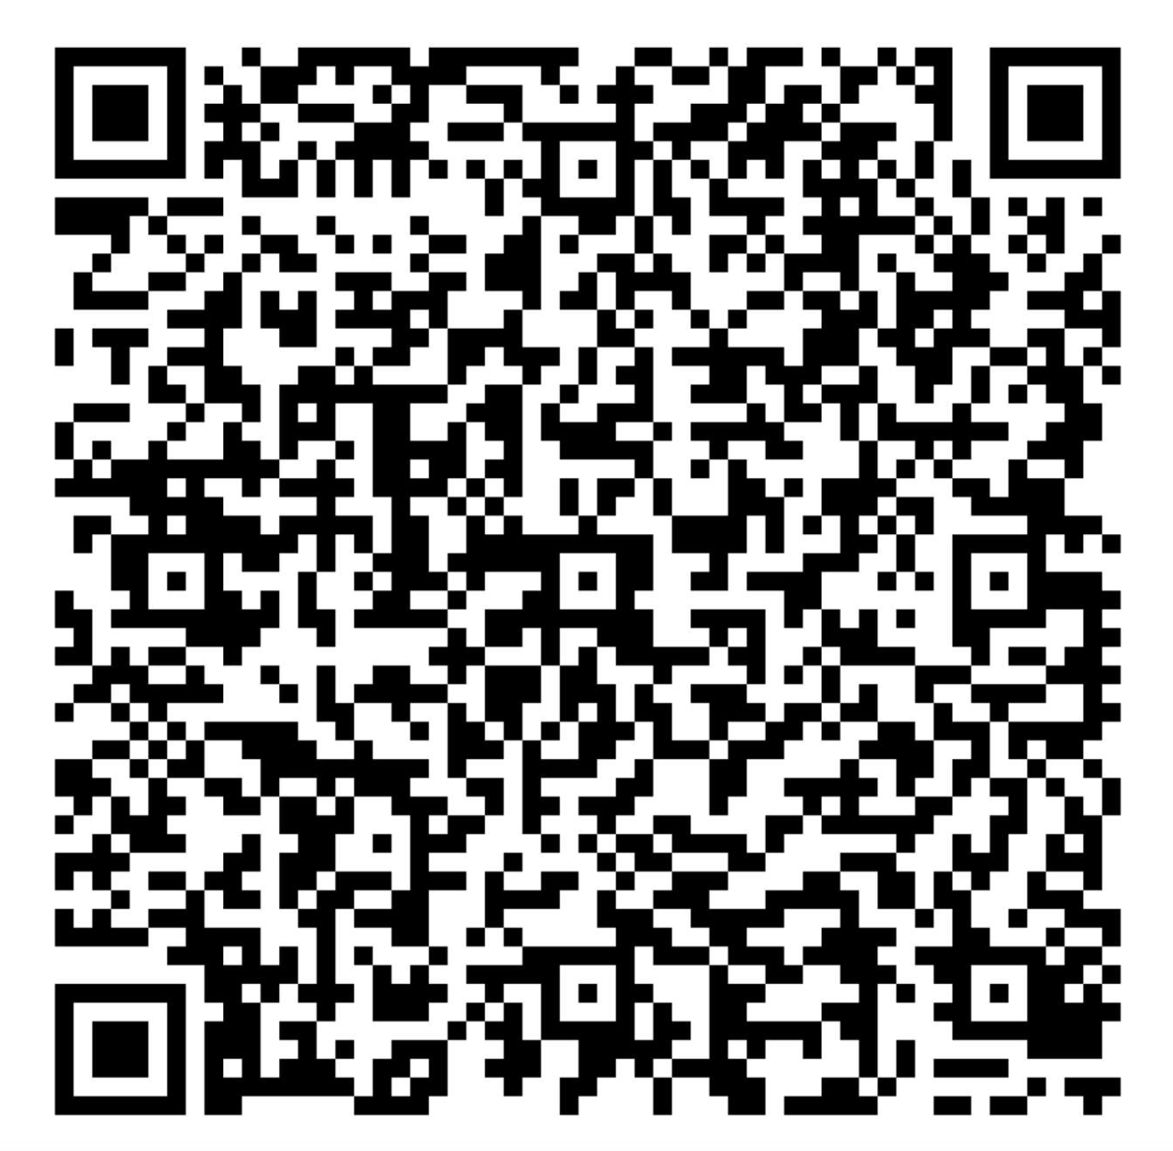
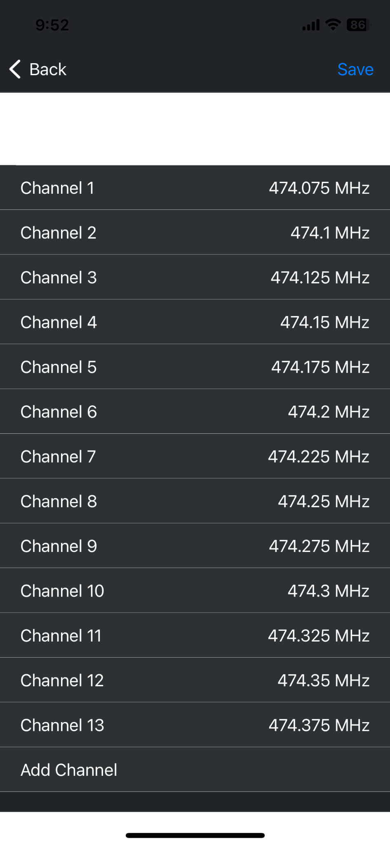
goTenna - Setup
First step is to set the frequency
1
Enter the frequency manually
2
Scan QR code
3 Control Channels
13 Data Channels
_{[6]}
[6] https://gotennapro.com/products/gotenna-pro-x

Slide 11
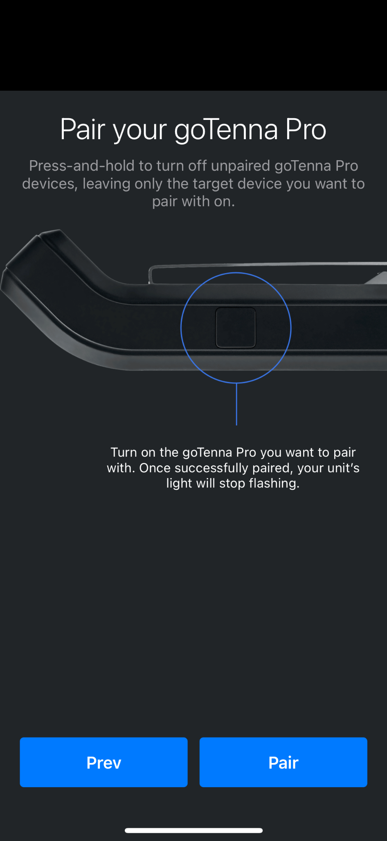
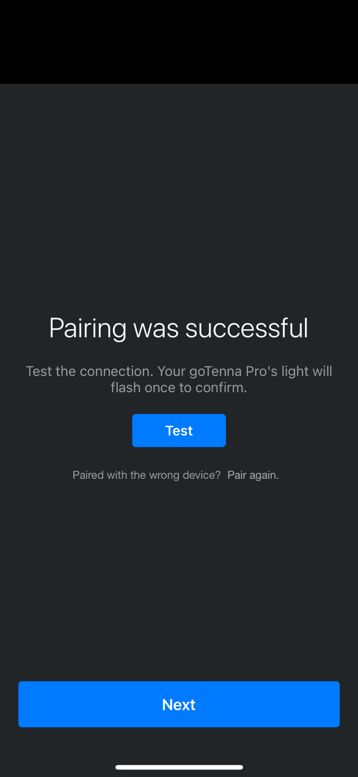
goTenna - Setup
Second step is pairing a goTenna Pro device to a smartphone
_{[6]}
_{[6]}
1
Press, hold, and release goTenna button to turn on the device
2
Press pair button on the mobile device
3
Successfully completed pairing
4
goTenna’s light flashes solid white for 2 seconds
[6] https://gotennapro.com/products/gotenna-pro-x
Notes:
A name for the frequency set.
Your license ID - FCC operating ID/callsign (this field is not reported and is for place keeping purposes only)
Max Power - The frequency's transmission power.
The Bandwidth - You may select 4.54, 7.28, or 11.8 kHz.
Control Channels - The channel on which transmission originates.
Data Channels - The channel over which the data packets are sent.
We recommend adding 3 Control channels and 13 Data channels for optimal performance
Antennas are frequency specific- You cannot mix VHF and UHF frequencies with the antennas provided with your goTenna purchase
Installation
Charge goTenna PRO fully before initial operation via the micro-USB port found at the bottom of the device. Device light will pulse white while charging, and will remain solid white when fully charged.
Install goTenna app on to smart phone.
Press, hold, and release the button to turn on the device. It will flash white one time to indicate it is on.
Follow pairing instruction inside phone app to pair to goTenna PRO. Light will flash a solid white for 2 seconds once pairing is successfully completed.
If you ever need to pair goTenna PRO with a new phone, simply press pair to new devices button inside the phone app to make the device capable of pairing with a new host device.
Operation
Follow on-boarding instruction inside app to set up your goTenna contact number. This is recommended to be your phone number.
Proceed to text, share GPS location, or send other data over the app using regular text-messaging app conventions. For more help please visit our FAQ online at www.gotenna.com/faq
We recommend placing the goTenna PRO in a unobstructed position, preferably as high up as possible on your person. For example, goTenna will work best when attached externally to the upper back of a backpack using the provided attachment strap.

Slide 12
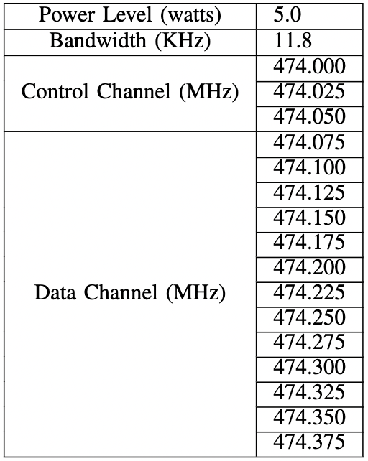
goTenna
goTenna Settings
1
UHF(Ultra high frequency) antenna
Power output and bandwidth were set to the maximum value for the optimal performance
2
Channel spacing for 11.8 KHz bandwidth to 0.025MHz
3
Control channel: channel on which transmission originates
Data channel: channel over which the data packets are sent
Notes:
More Bandwidth Requires More Power or Antennas.
The more bandwidth a data connection has, the more data it can send and receive at one time.

Slide 13
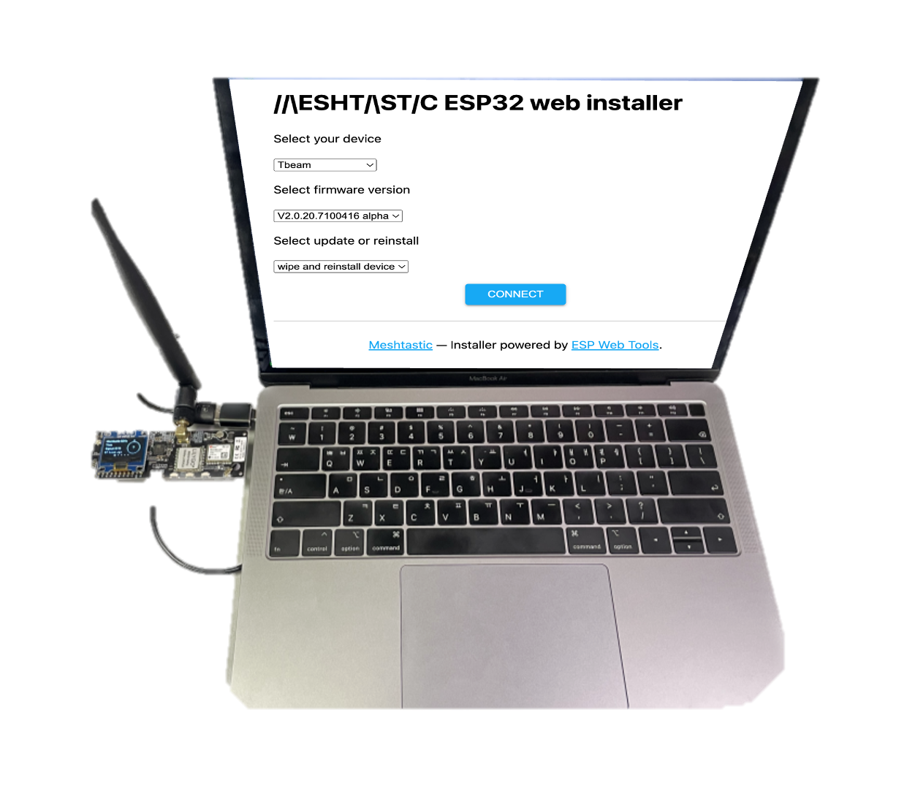
Meshtastic - Setup
First step is to set the physical device
Requires a Meshtastic supported microcontroller unit
_{[7]}
1
Connect the LILYGO TTGO T-BEAM² to the laptop
2
Open Web-Based firmware flasher
3
Select firmware version: V2.0.20.7100416 alpha
4
Click on the Connect button.
[7] Meshtastic, “Meshtastic ESP32 web installer,” Accessed: Jan. 29 2023 [Online]. Available: https://flasher.meshtastic.org/
Notes:
We have six predefined channels. These are the most common settings and have been proven to work well:
Spreading Factor - How much we "spread" our data over time.
Each step up in Spreading Factor doubles the airtime to transmit.
Each step up in Spreading Factor adds about 2.5db extra link budget.
Bandwidth - How big of a slice of the spectrum we use.
Each doubling of the bandwidth is almost 3db less link budget.
Bandwidths less than 31 may be unstable unless you have a high quality Crystal Oscillator.
Coding Rate - How much redundancy we encode to resist noise.
Increasing coding rate increases reliability while decreasing data-rate.
4/5 - 1.25x overhead
4/6 - 1.5x overhead
4/7 - 1.75x overhead
4/8 - 2x overhead
ESP32​
The ESP32 chip is older and consumes more power than the nRF52 chip, but is equipped with both WiFi and Bluetooth. Supported ESP32 devices:
LILYGO® TTGO T-Beam
LILYGO® TTGO Lora
Nano G1
Station G1
Heltec V3 and Wireless Stick Lite V3
Flash Firmware​
After installing the serial drivers, you can now flash the Meshtastic firmware onto your device. To proceed, select the appropriate device type for your device.
Flashing Method for ESP32 Devices​
The Web-Based Installer requires either Chrome or Edge browsers but is an excellent choice for quickly flashing devices. This method is highly recommended for firmware flashing, especially for new users of the project, as it is easy to use.

Slide 14
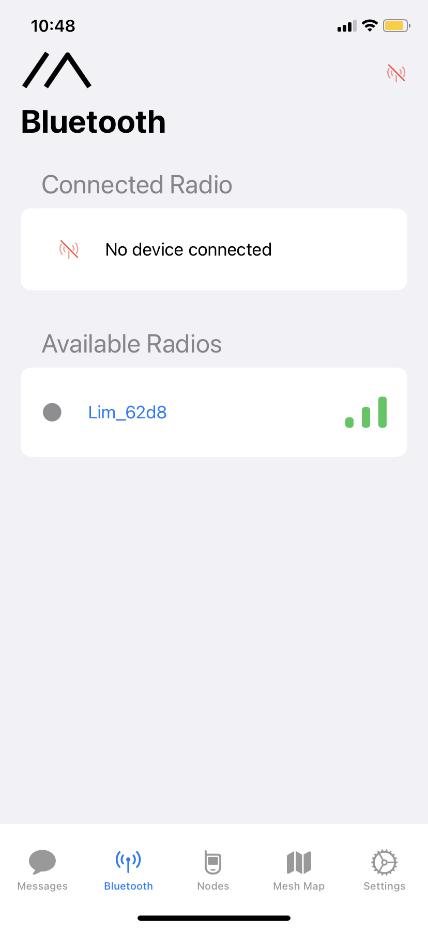
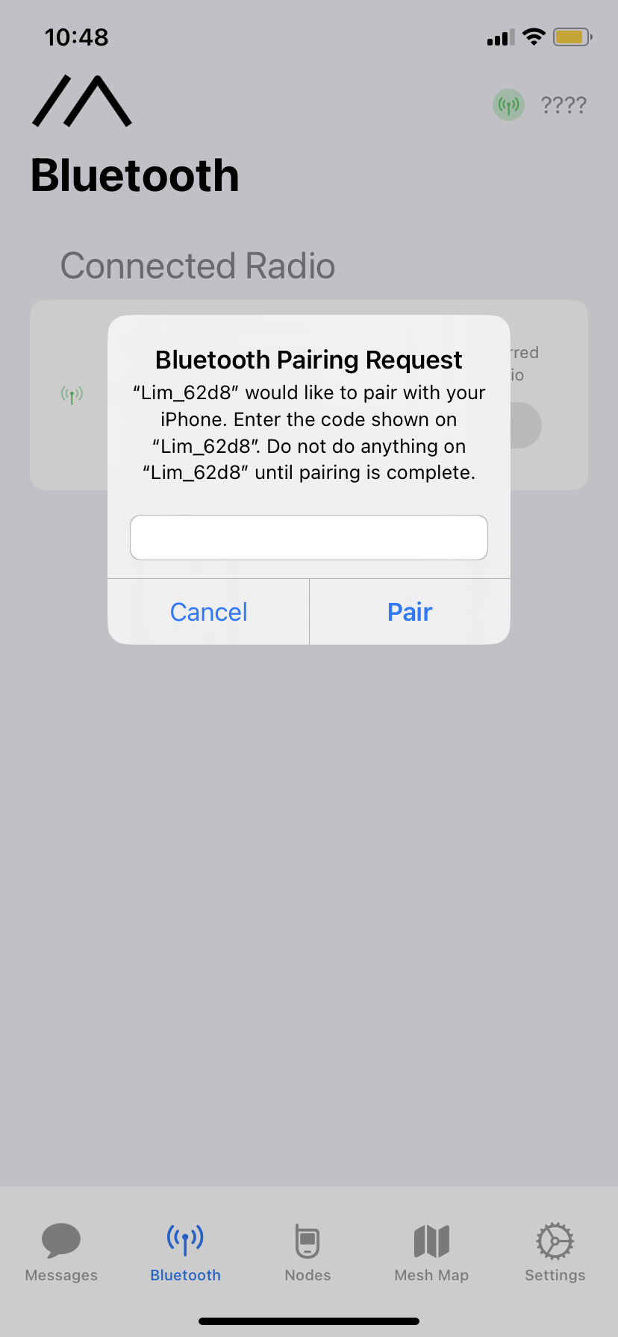
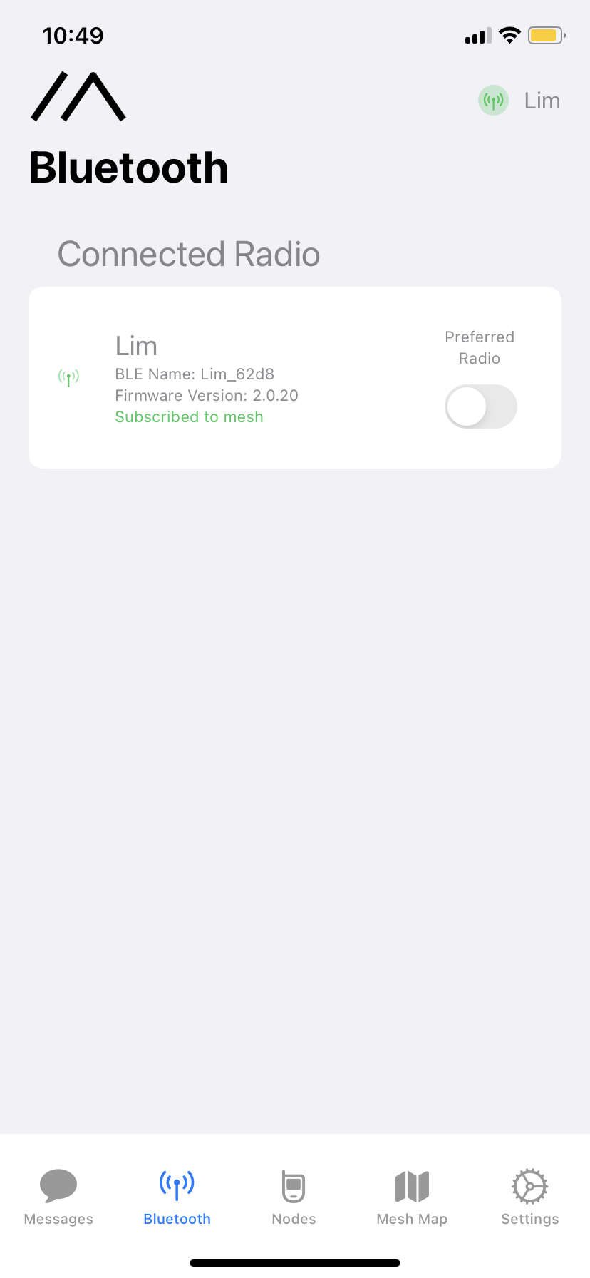
Meshtastic - Setup
Second step is to pair the microcontroller to the mobile application
_{[5]}
_{[11]}
1
LILYGO turned on
2
Click on the available radio
3
Enter pin code on smartphone device
4
Click Pair
[7] Meshtastic, “Meshtastic ESP32 web installer,” Accessed: Jan. 29 2023 [Online]. Available: https://meshtastic.org/

Slide 15
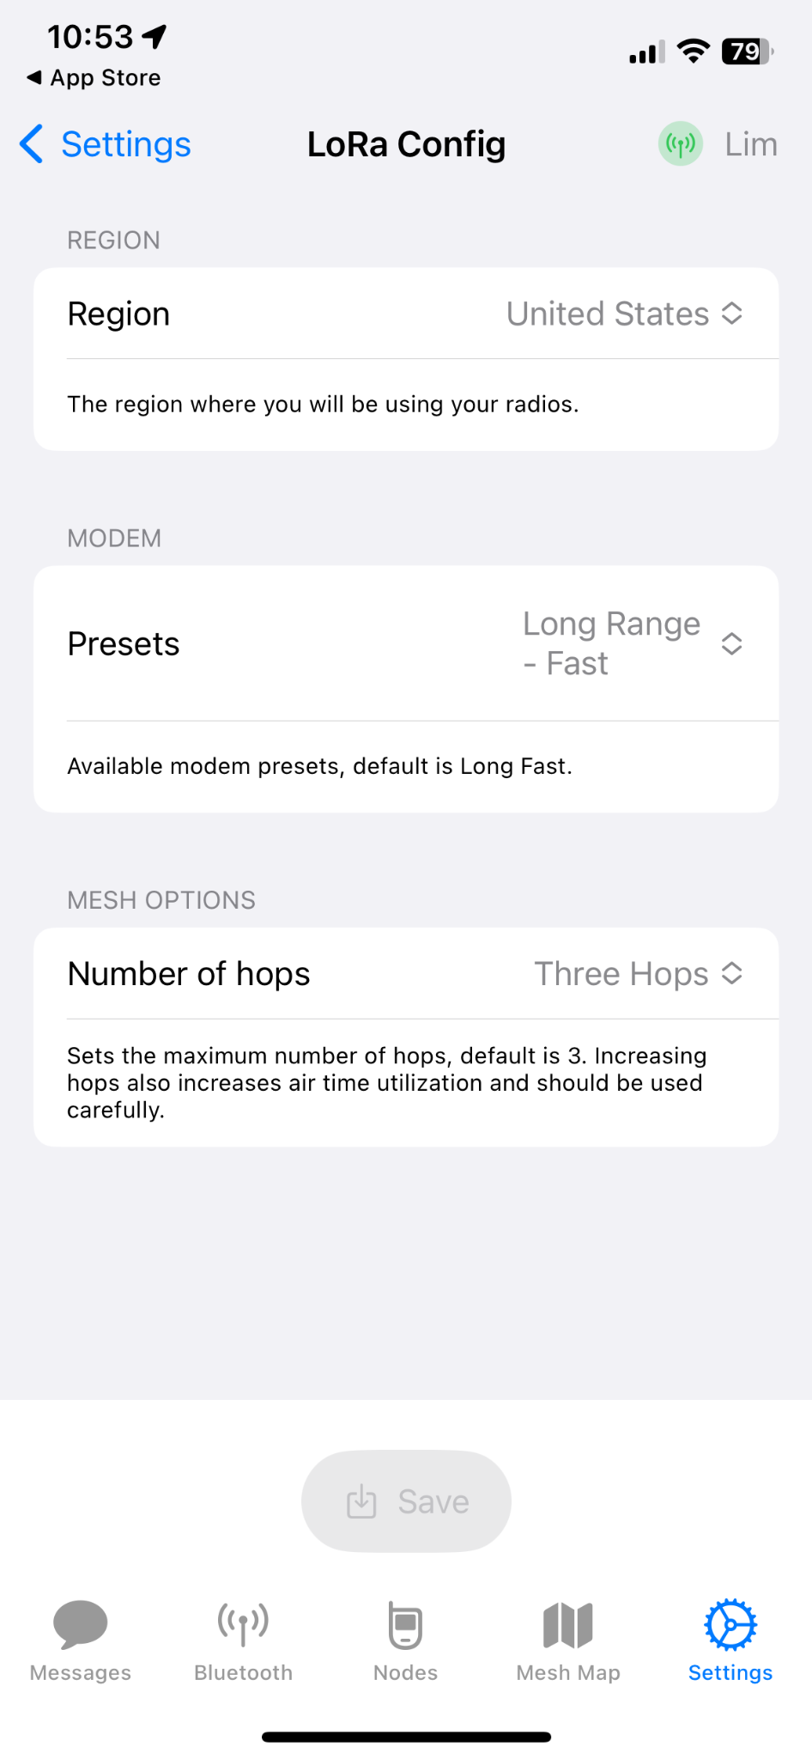
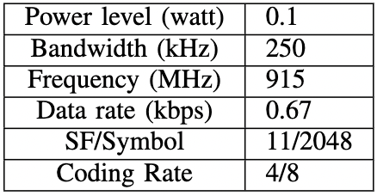
Meshtastic - Setup
_{[7]}
Meshtastic Settings
1
Region: United States
2
Modem Preset: Long Range - Fast
3
Number of hops: Three Hops
Long Range-Fast (Default)

Slide 16
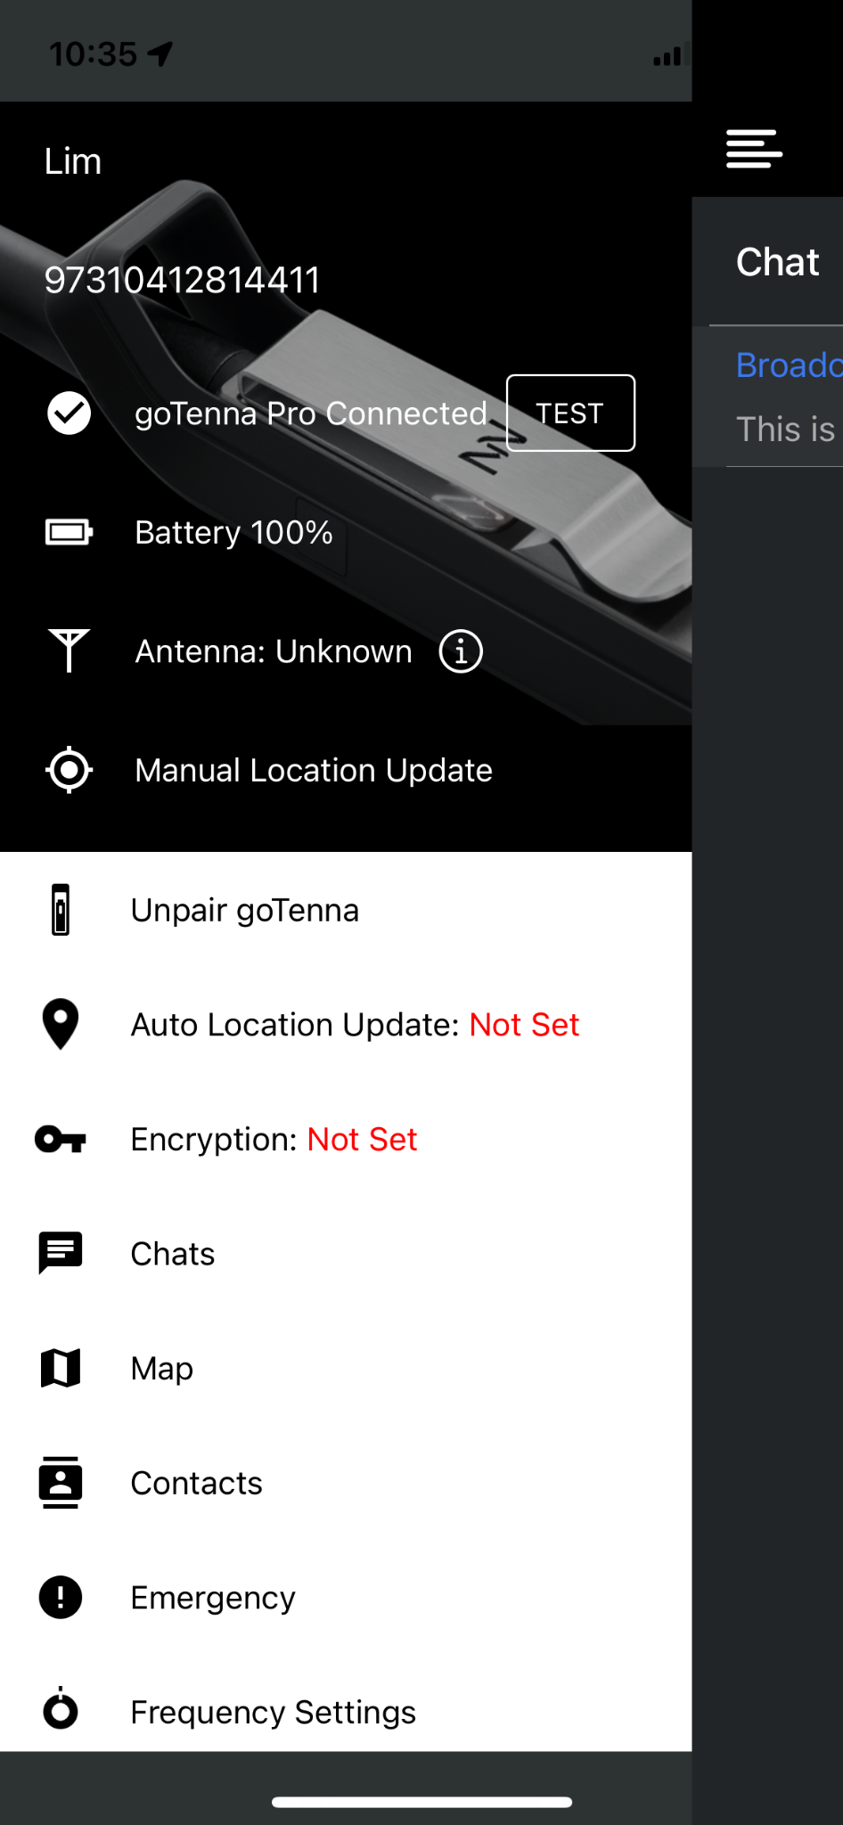
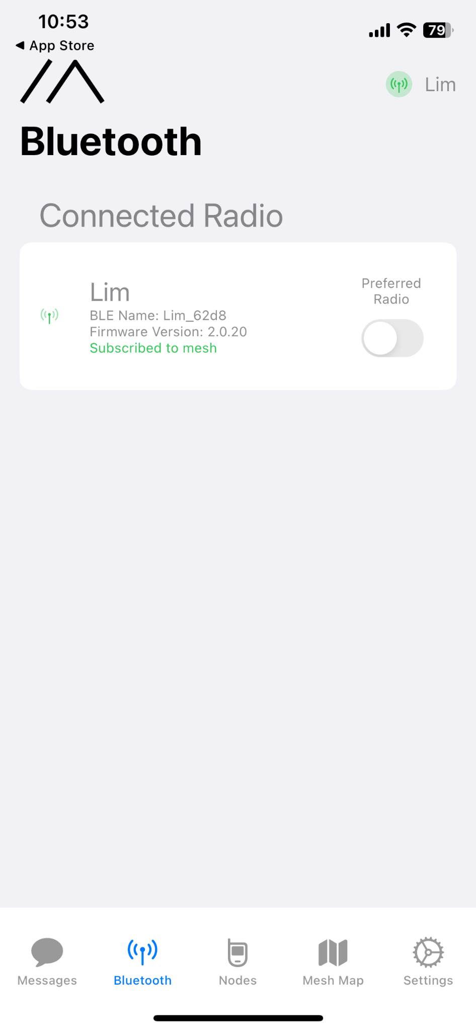
Graphic User Interface: goTenna and Meshtastic
_{[6]}
_{[7]}
Notes:
When you are successfully connected to goTenna Pro X and Meshtastic you can see this GUI interface on its mobile app.

Slide 17
Testing Environment
03

Slide 18
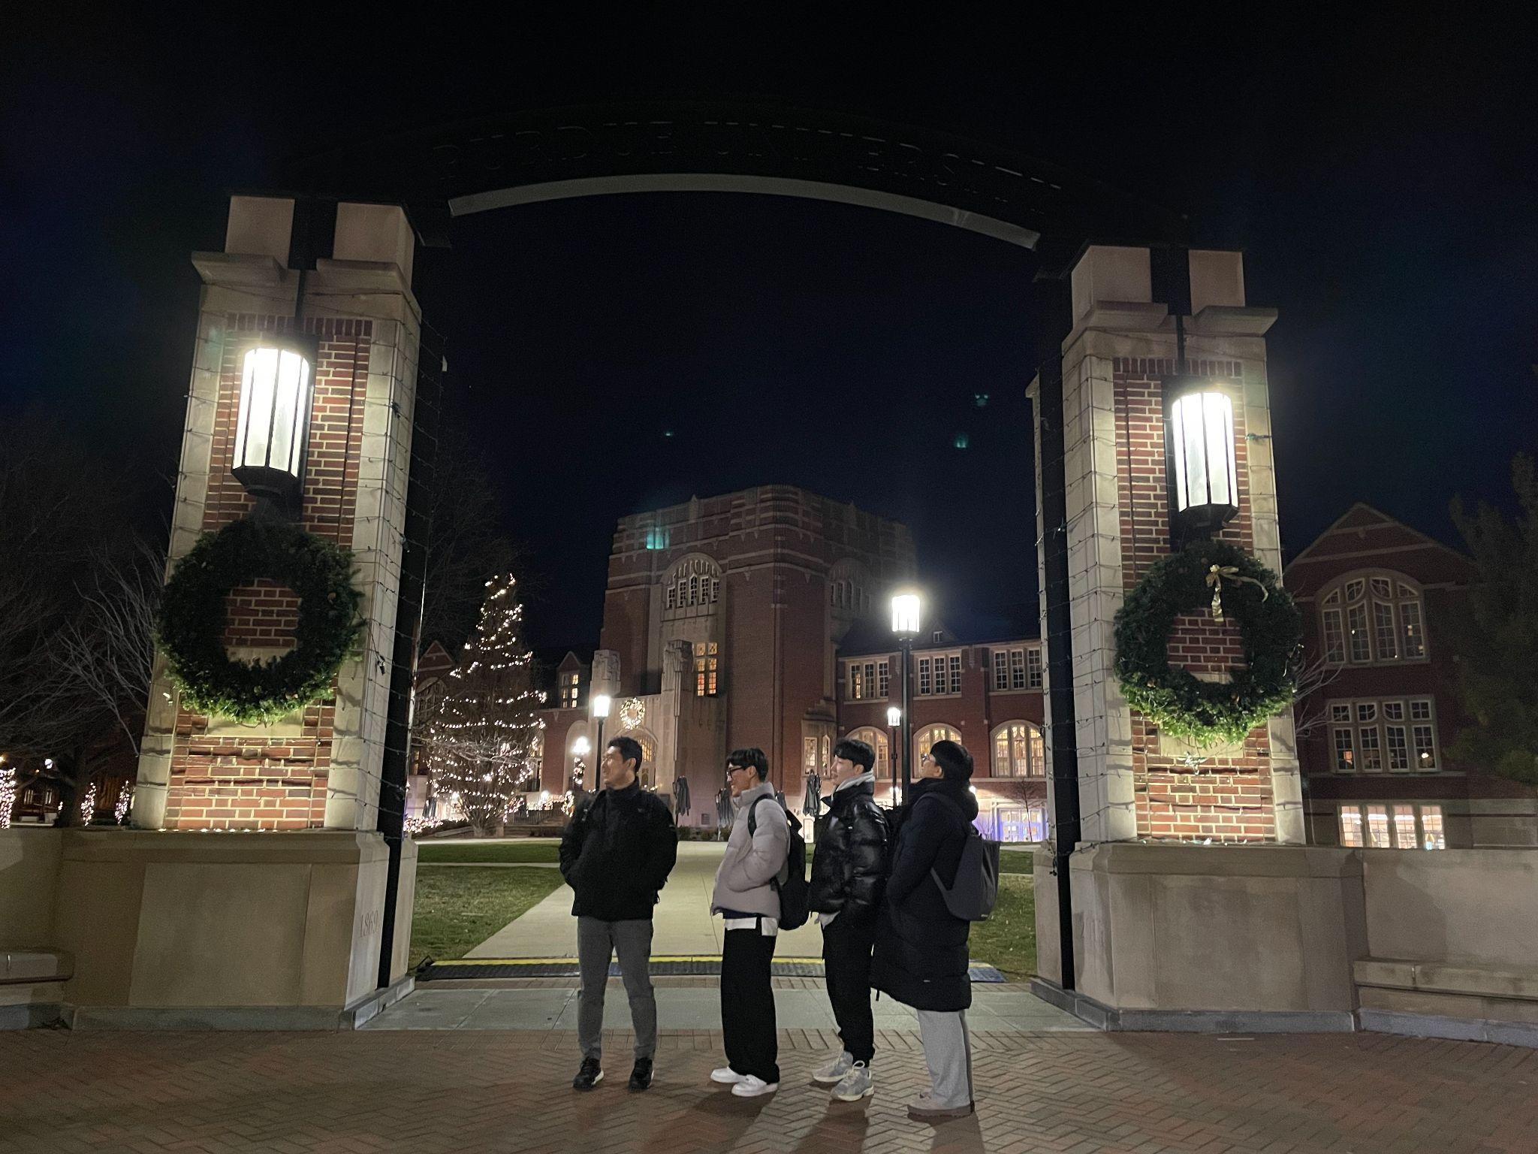
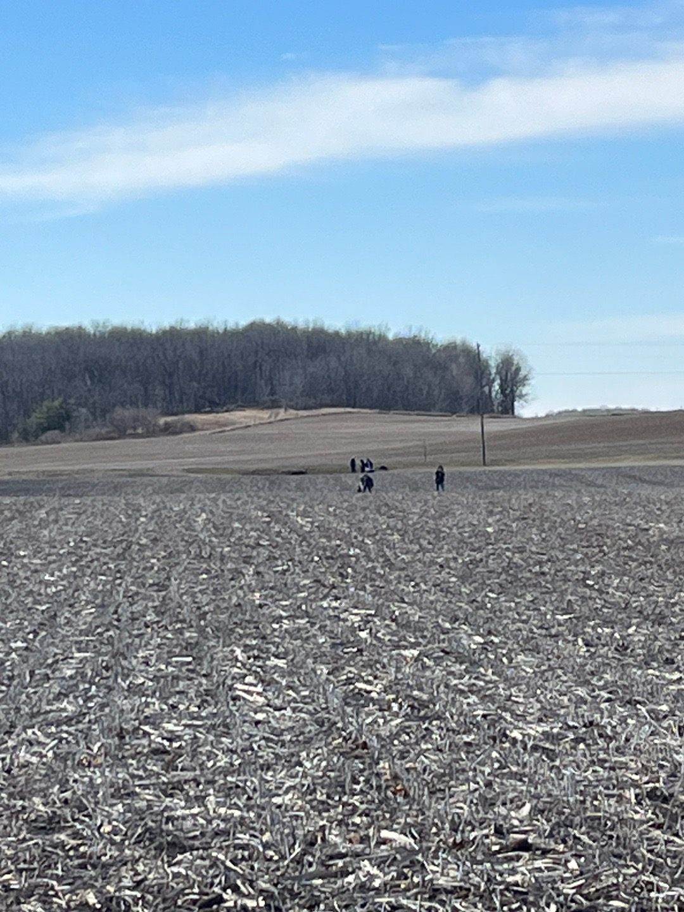
Environment setting
University Campus (Urban)
Farm (Rural)

Slide 19


Case 1 - Campus
First experiment in campus
Objective
Approach
Overcome the challenge of potential infrastructure disruptions
Three nodes were placed in parking lot near Knoy, Purdue Memorial Union and Krannert

Slide 20
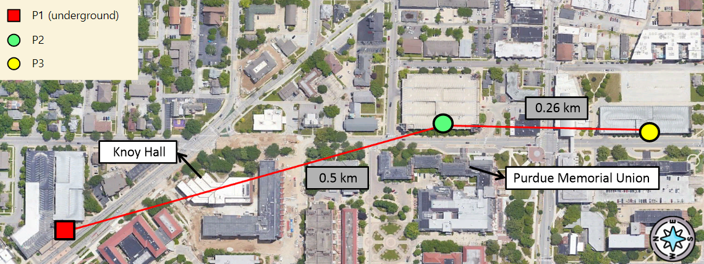
Case 1 - Campus
Notes:
This technology, known as Aspen Grove™, allows for long-range, short-burst mobile mesh networking through a unique approach that uses no control-packets to achieve optimal network efficiency
it broadcasts information and creates a decentralized mesh network, allowing users to send texts and share locations in a group chats and private messages using an app on their device

Slide 21
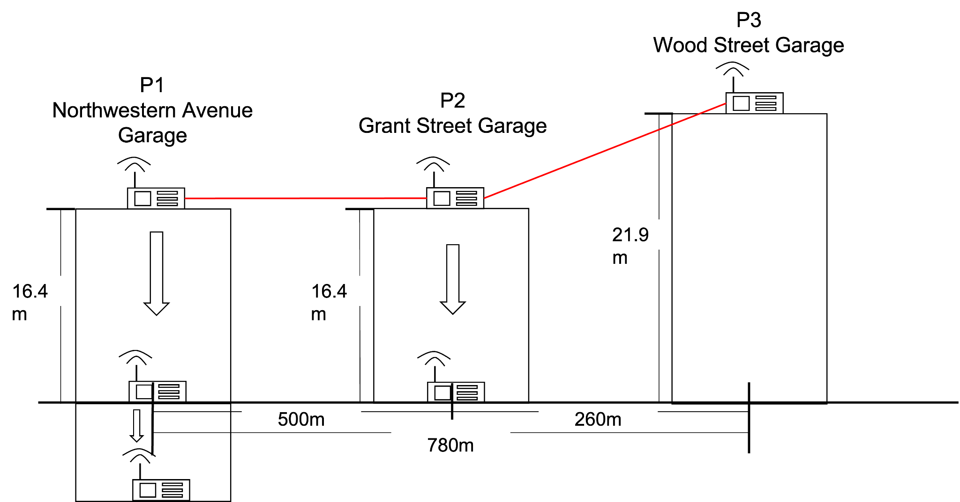
Case 1 - Campus
First experiment in campus
1
The endpoint P3 was fixed
2
The endpoint P1 changed to various positions
It changed its position such as
on the roof
inside the parking lot
outside the parking lot
underground tunnel

Slide 22
Case 1 - Campus
Difficulties
1
Weak Antenna Signals
Both goTenna Pro X and Meshtastic had weak signals in the tunnels
2
Inconsistency
The relay node (P2) had to move to different positions within the parking lot to receive the message from P1
3
Uncertainty
The relay node (P2) was only 260m away from P3

Slide 23
Case 1 - Campus
Second experiment in Campus
Objective
Approach
Verify the messages could be sent in the tunnel to other nodes
Change the process by adding an additional relay node (P2) which was placed in the same parking lot as P1 (Knoy)

Slide 24
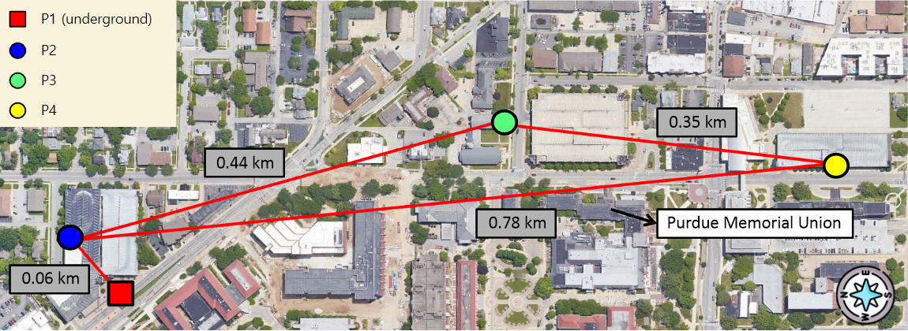
Case 1 - second experiment
Notes:
This technology, known as Aspen Grove™, allows for long-range, short-burst mobile mesh networking through a unique approach that uses no control-packets to achieve optimal network efficiency
it broadcasts information and creates a decentralized mesh network, allowing users to send texts and share locations in a group chats and private messages using an app on their device

Slide 25
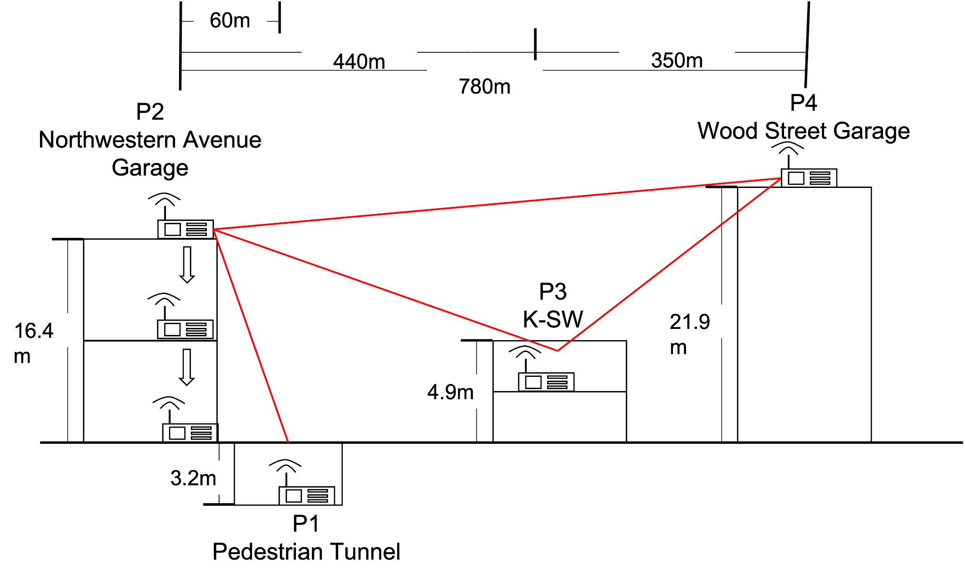
Case 1 - Campus
Second experiment in Campus
1
The endpoint P1 & P4 were fixed
P1 located in the tunnel
P4 located on the roof
2
P3 connected endpoints acting as a relay
3
The new relay node P2 were moved
It changed its position such as
on the roof
inside the parking lot
outside the parking lot

Slide 26
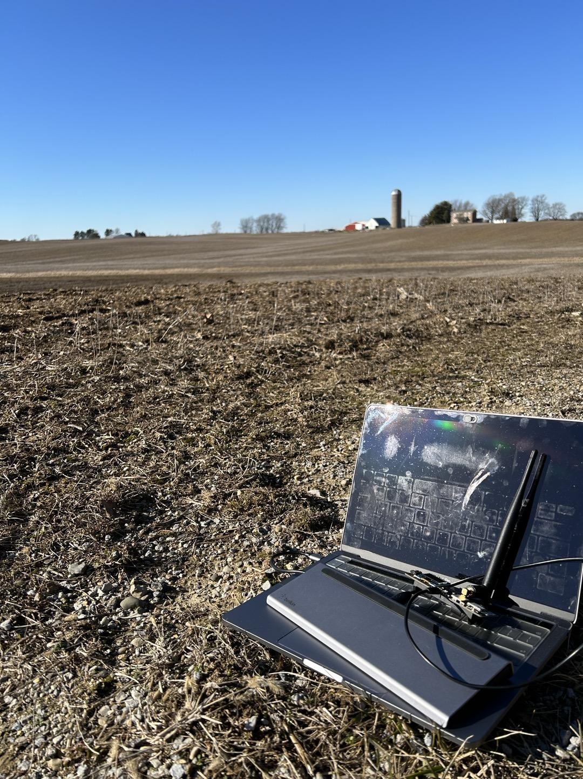

Case 2 - Farm
Experiment on the farm
Objective
Location
Establish the furthest distance at which point-to-point communication could be reliably maintained
Professor Tony’s farm
Wide open field with no obstructions
Clear line of sight and good weather

Slide 27
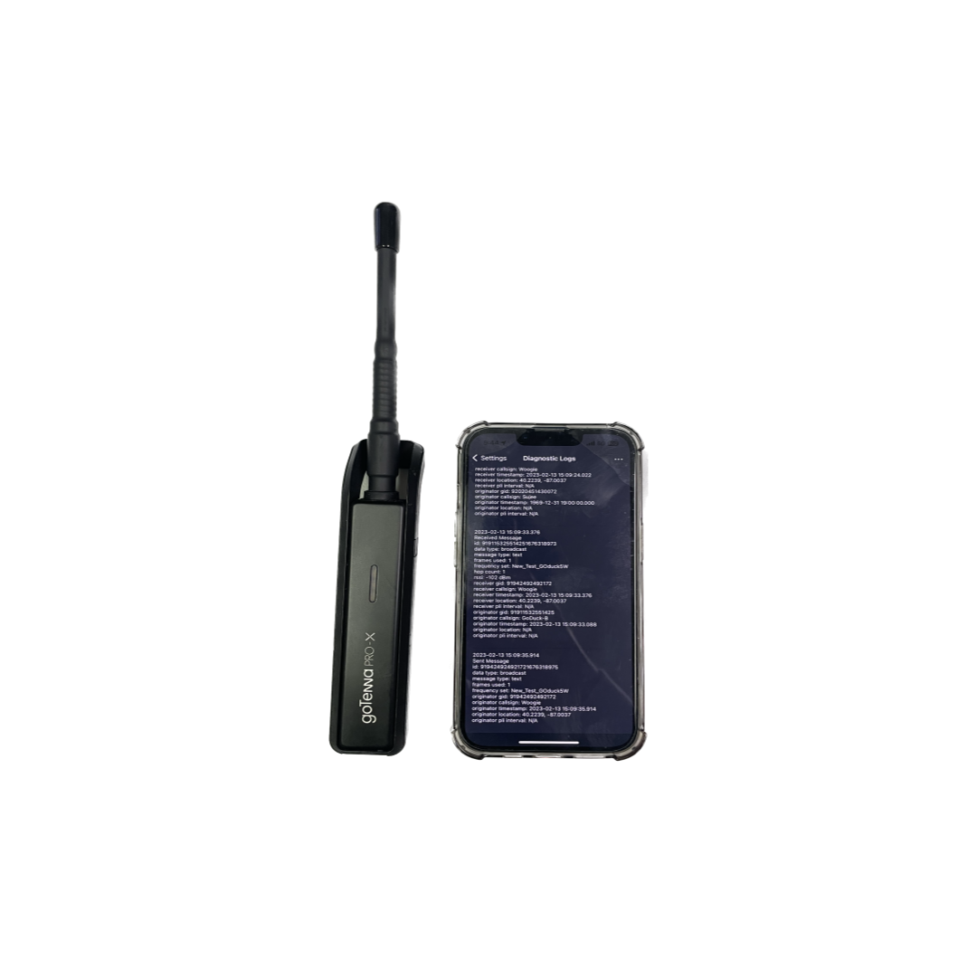
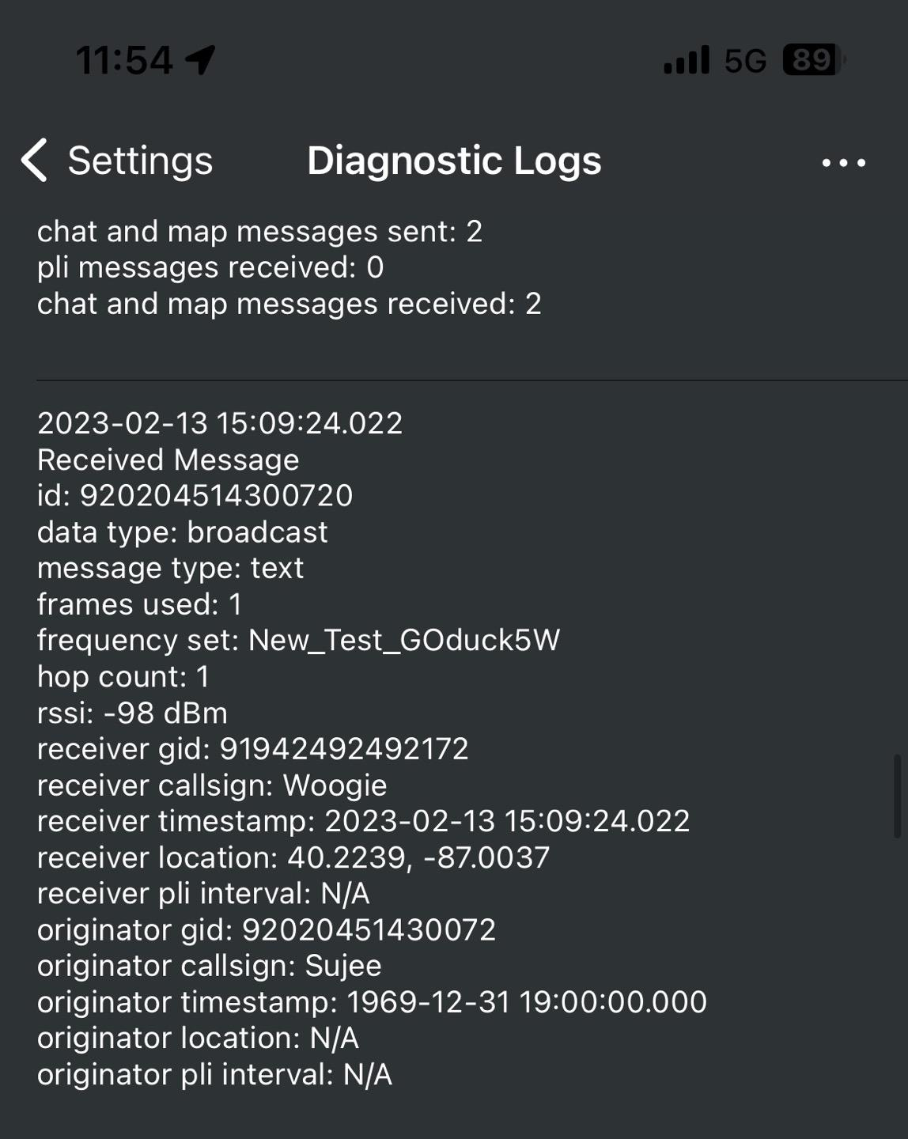
goTenna - Data Collection
_{[6]}
Enhanced diagnostic logs - iOS Application

Slide 28
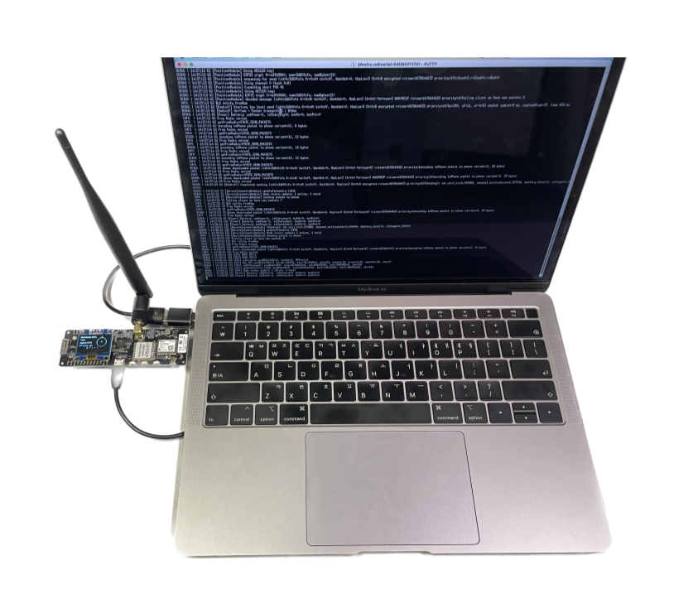
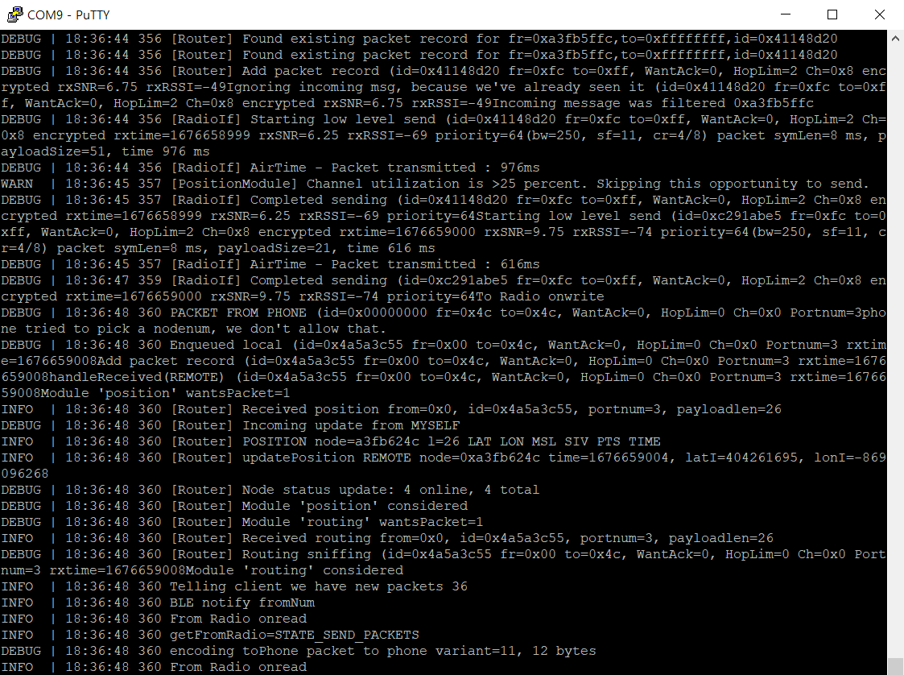
Meshtastic - Data Collection
Data collection and Log analysis - PuTTY
_{[8]}
[8] putty, “putty,” Accessed: Jan. 30 2023 [Online]. Available: https://www.putty.org/

Slide 29
Experiment
04

Slide 30
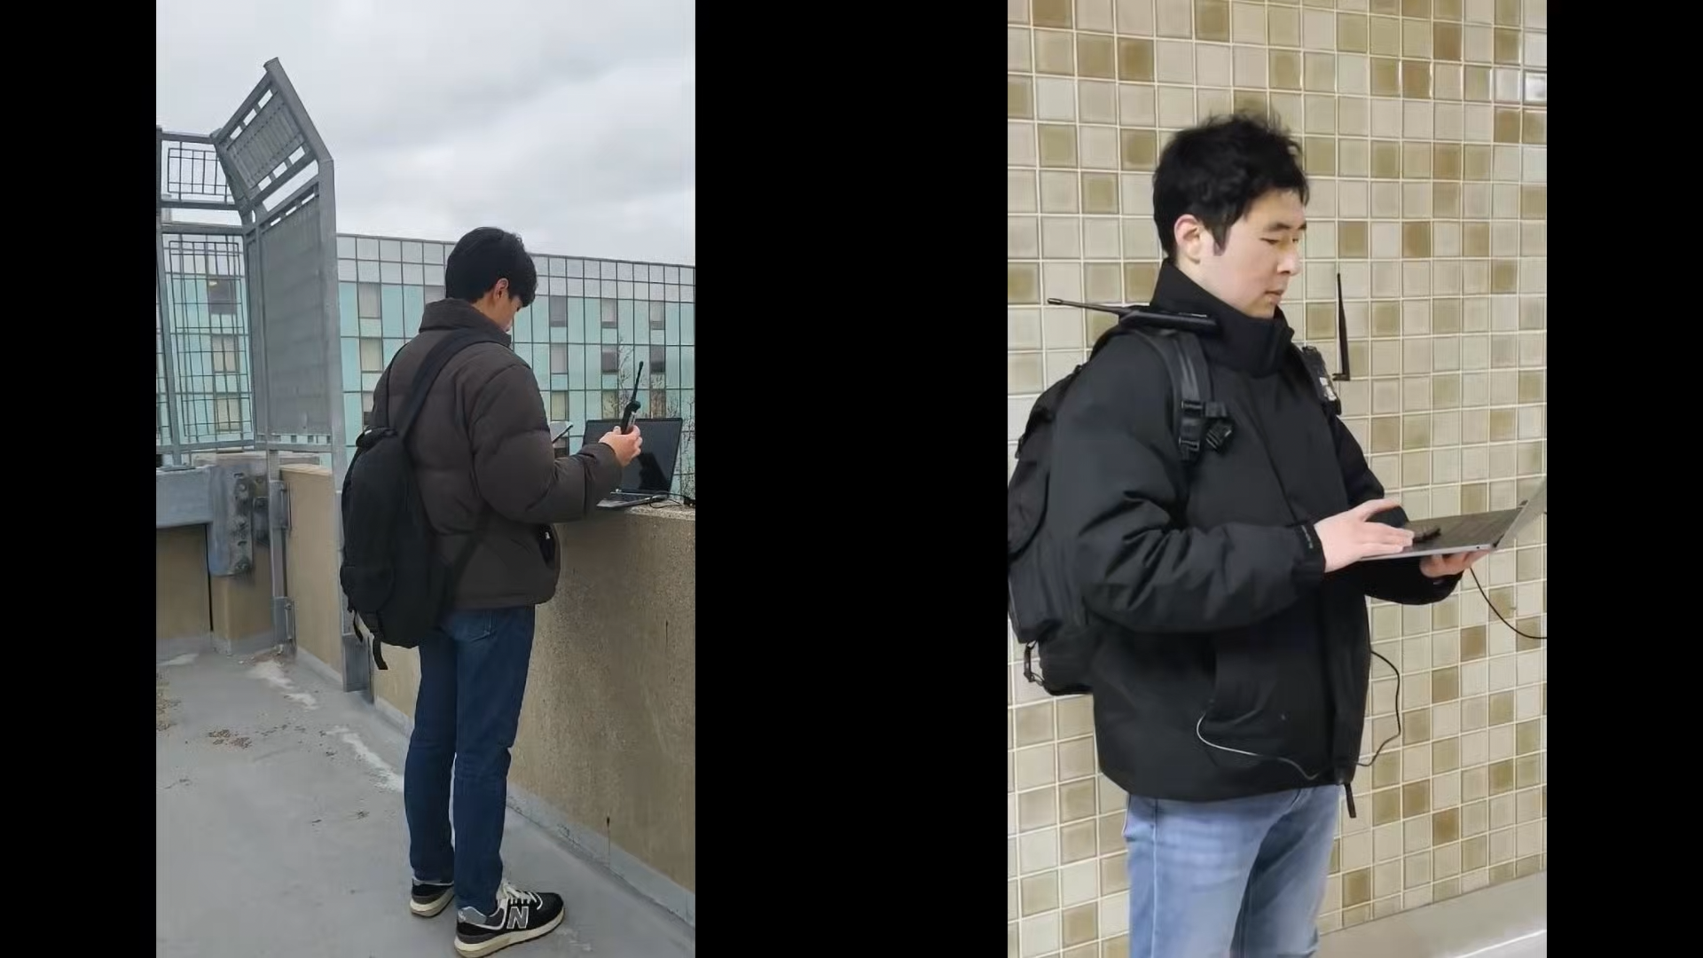
Demo
Notes:
This technology, known as Aspen Grove™, allows for long-range, short-burst mobile mesh networking through a unique approach that uses no control-packets to achieve optimal network efficiency
it broadcasts information and creates a decentralized mesh network, allowing users to send texts and share locations in a group chats and private messages using an app on their device

Slide 31
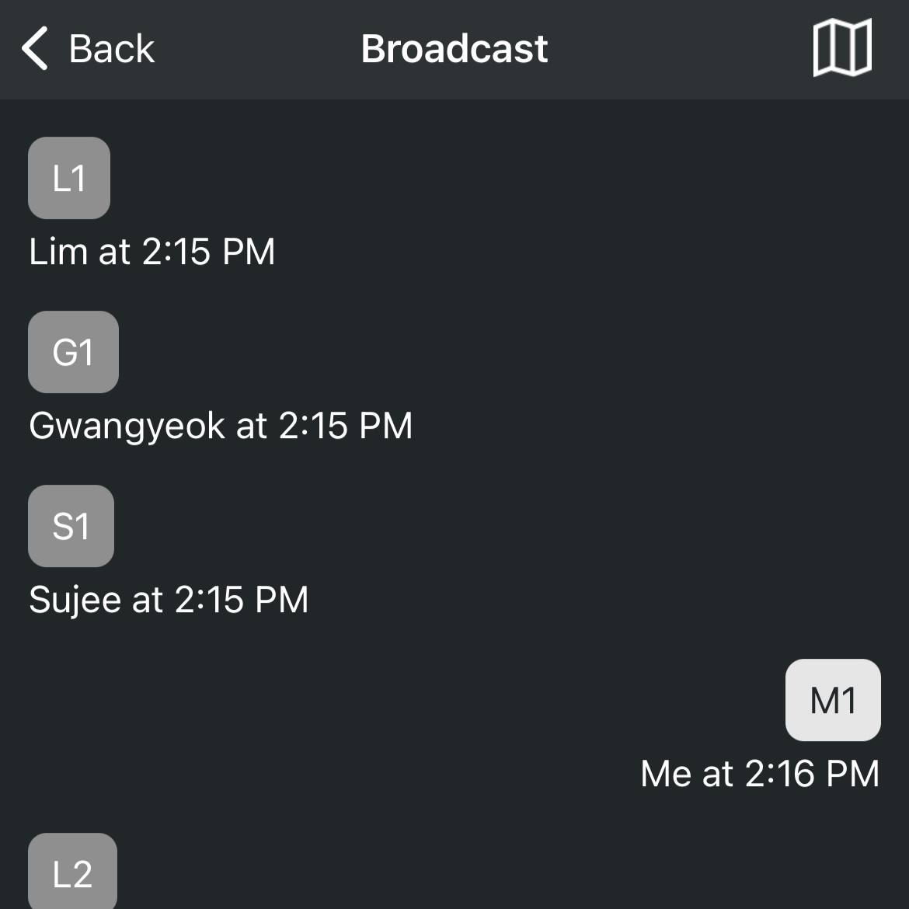
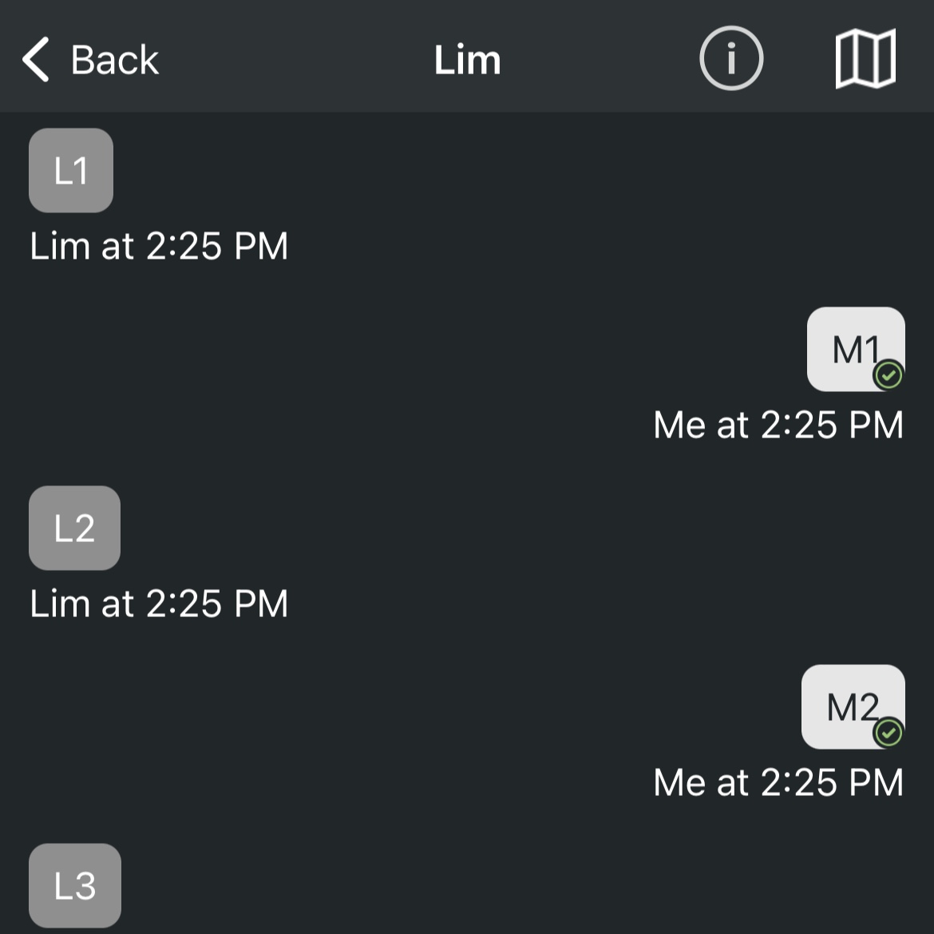
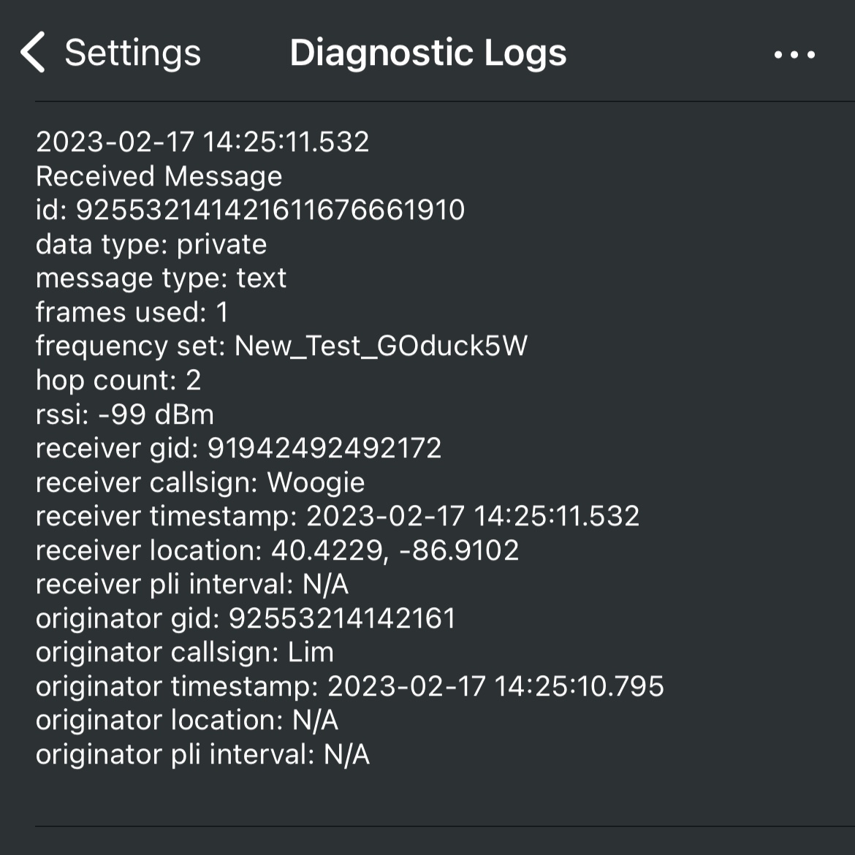
Case 1 - On Campus
The test consists of three steps
Send a broadcast chat for three times and reply back when received
Send a private chat for three times and reply back when received
Record the results and change the location
_{[6]}
_{[6]}
_{[6]}

Slide 32
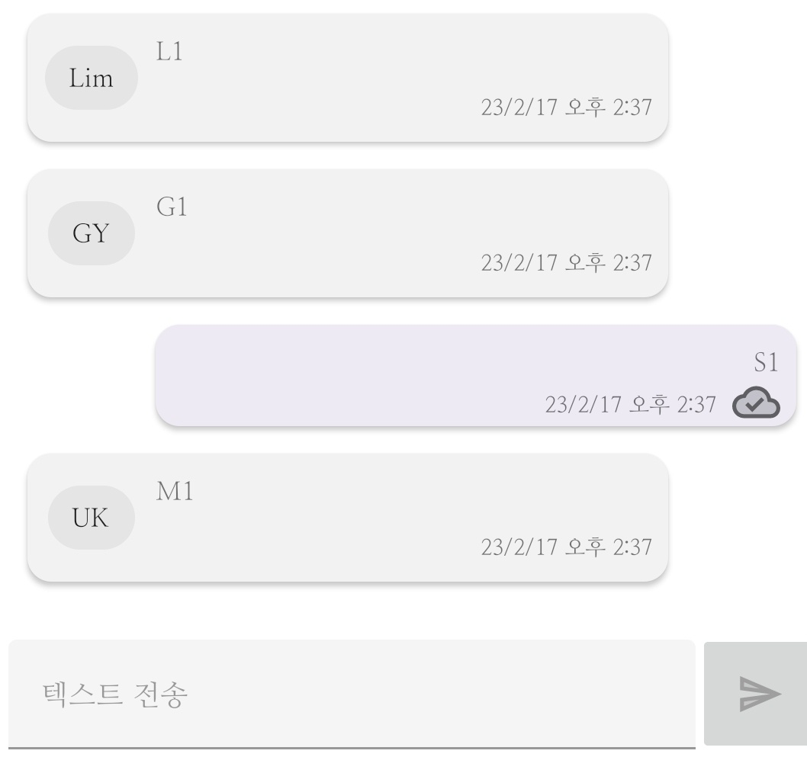
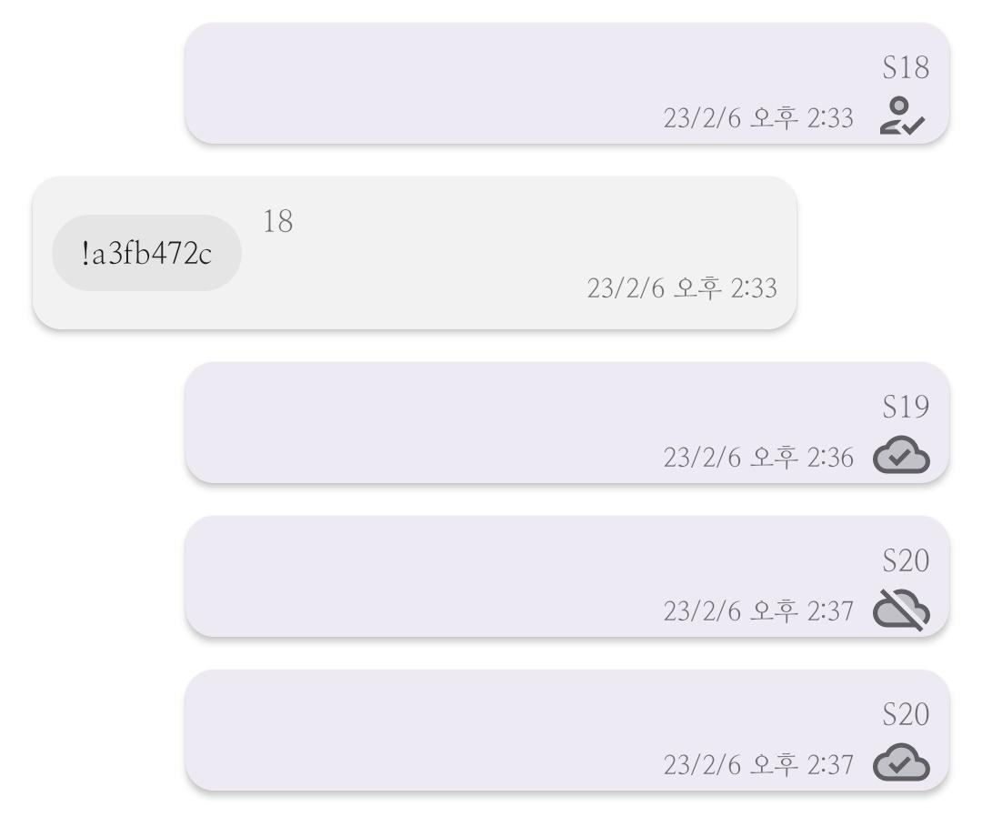
Case 1 - On Campus
The test consists of three steps
Use PuTTY for collecting data logs
Send a broadcast chat for three times and reply back when received
Send a private chat for three times and reply back when received
_{[7]}
_{[7]}

Slide 33
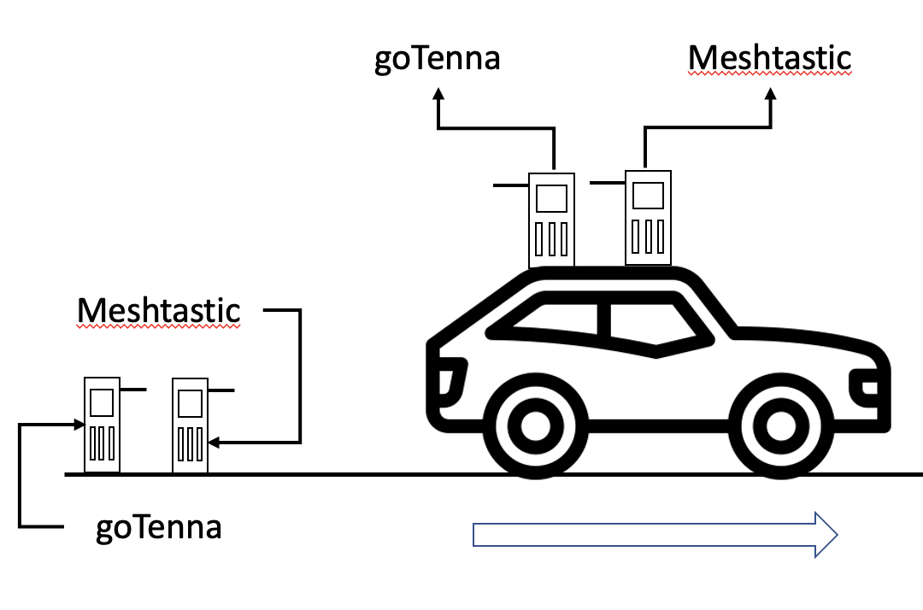
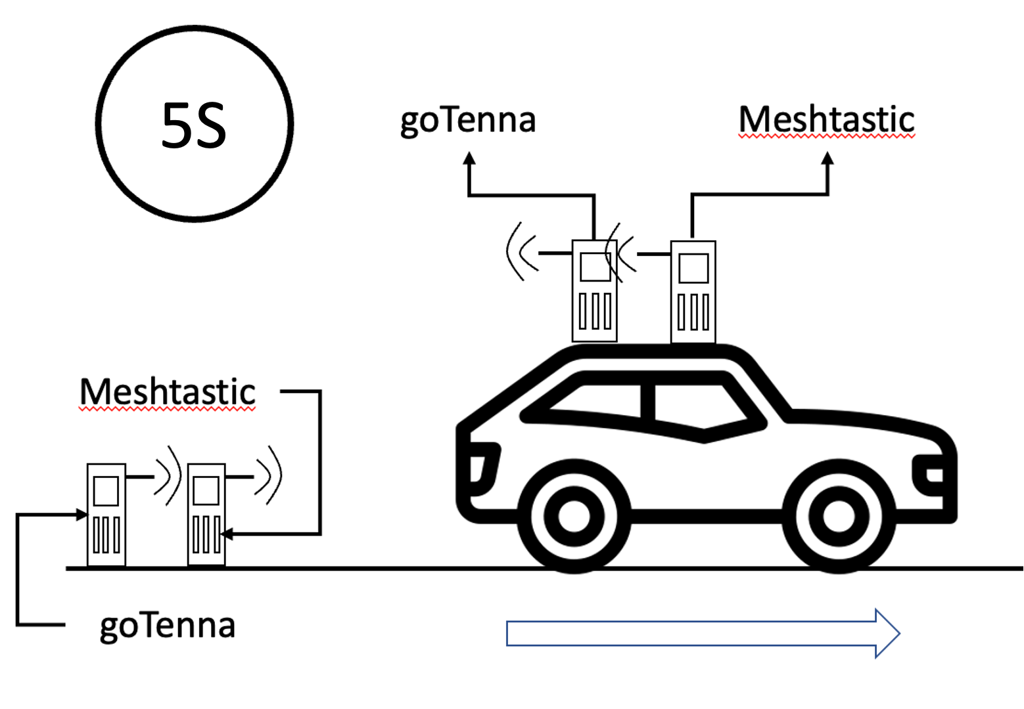
Case 2 - Farm
The test consists of four steps
Every 5 seconds, a broadcast message was sent from the fixed endpoint, and a reply was sent back when the message was received.
One endpoint was fixed, while the other moved in a one direction by car
2
1
Notes:
This technology, known as Aspen Grove™, allows for long-range, short-burst mobile mesh networking through a unique approach that uses no control-packets to achieve optimal network efficiency
it broadcasts information and creates a decentralized mesh network, allowing users to send texts and share locations in a group chats and private messages using an app on their device

Slide 34
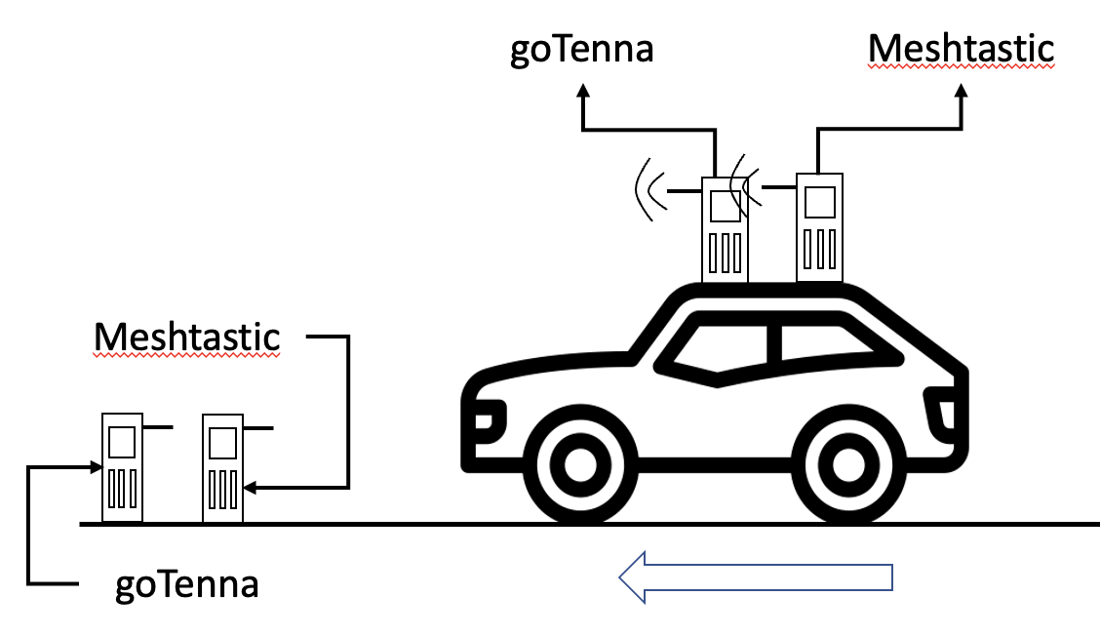
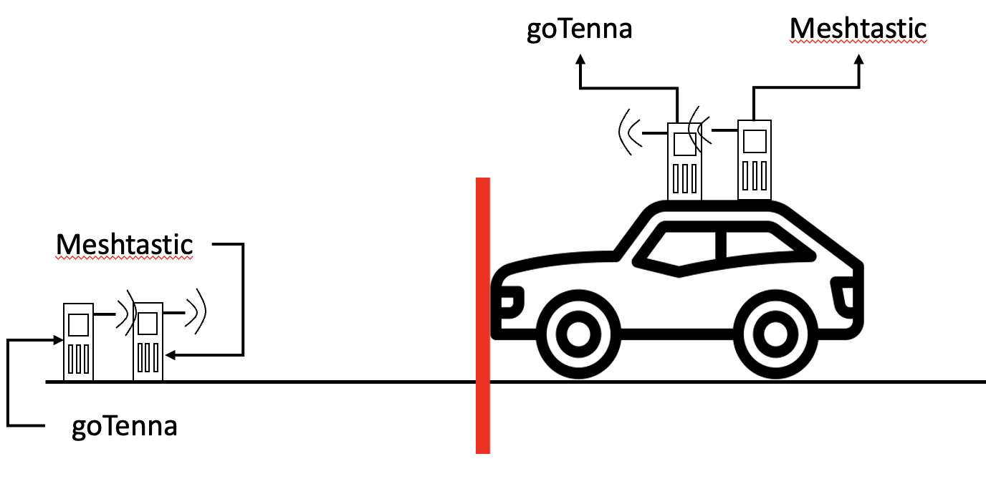
Case 2 - Farm
The test consists of four steps
After identifying the point at which communication ends, the location and the maximum range was recorded.
If the communication ends, the moving endpoint would move closer to the starting point until it gets the communication.
4
3
Notes:
This technology, known as Aspen Grove™, allows for long-range, short-burst mobile mesh networking through a unique approach that uses no control-packets to achieve optimal network efficiency
it broadcasts information and creates a decentralized mesh network, allowing users to send texts and share locations in a group chats and private messages using an app on their device

Slide 35
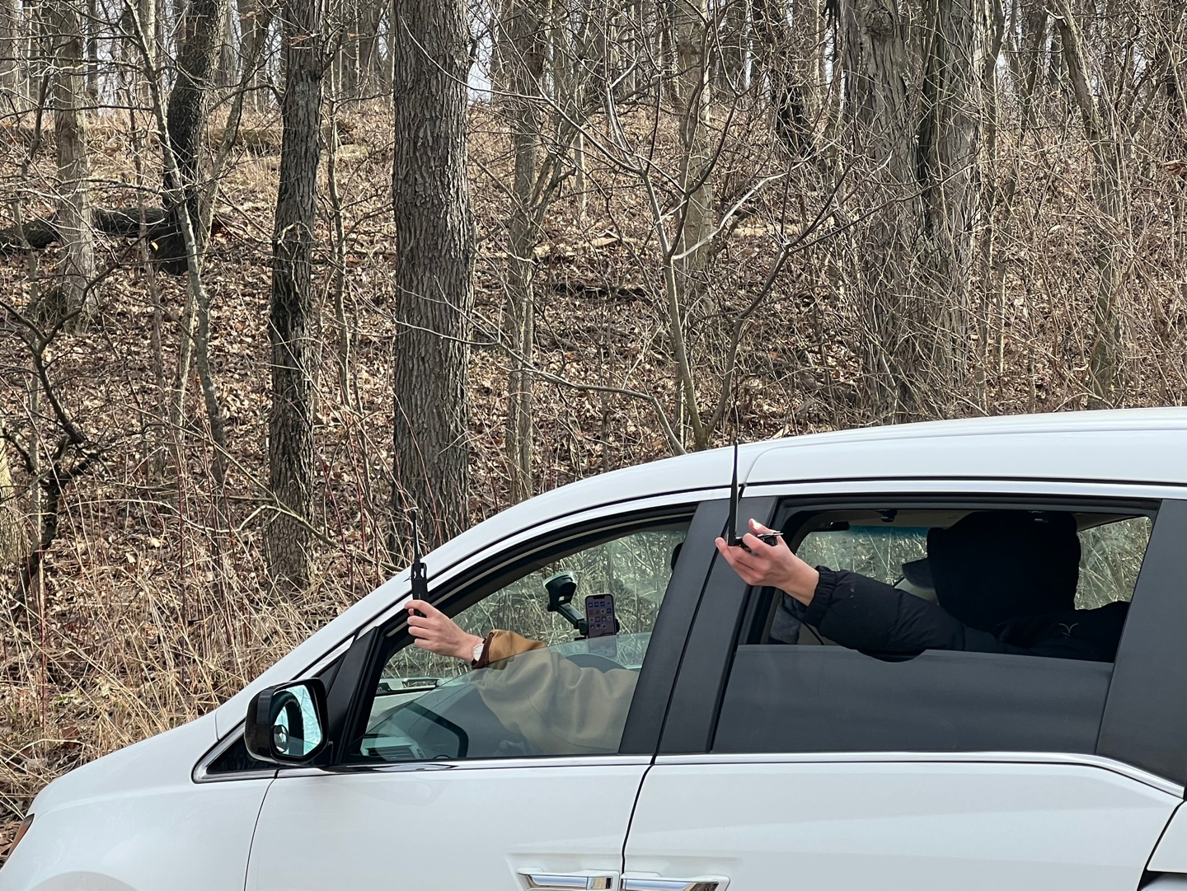
Case 2 - Farm
Notes:
This technology, known as Aspen Grove™, allows for long-range, short-burst mobile mesh networking through a unique approach that uses no control-packets to achieve optimal network efficiency
it broadcasts information and creates a decentralized mesh network, allowing users to send texts and share locations in a group chats and private messages using an app on their device

Slide 36
Result & Conclusion
05

Slide 37
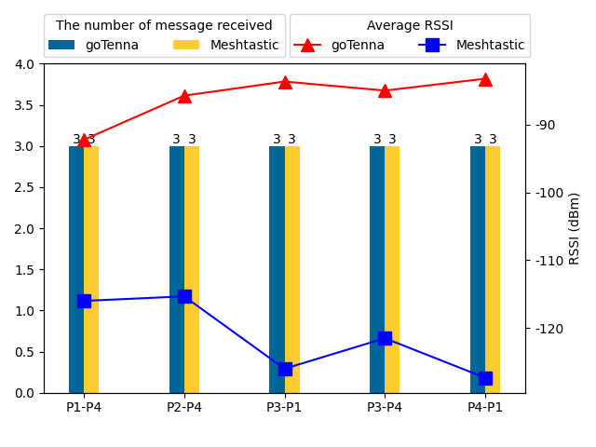
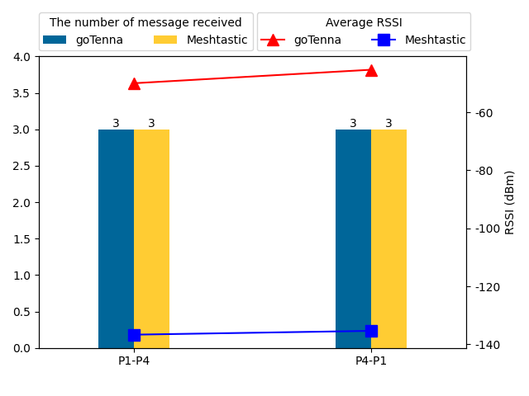
Result - Campus
Result on the rooftop
Broadcast chat
Private chat
Private messages were relayed as well, without granting access to the contents to the relay node. (P1 - P2 - P4)
Notes:
This technology, known as Aspen Grove™, allows for long-range, short-burst mobile mesh networking through a unique approach that uses no control-packets to achieve optimal network efficiency
it broadcasts information and creates a decentralized mesh network, allowing users to send texts and share locations in a group chats and private messages using an app on their device

Slide 38
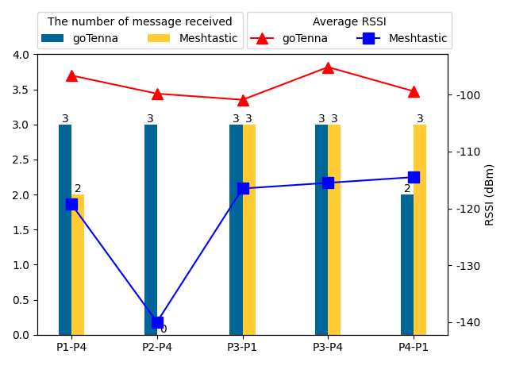
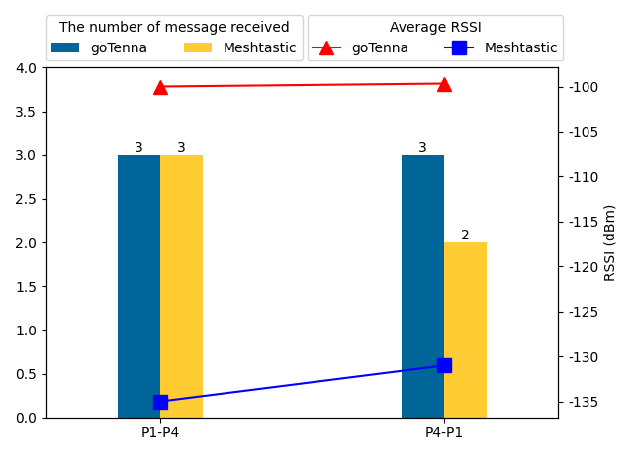
Result - Campus
Result on the 3rd floor (Inside the parking lot)
Broadcast chat
Private chat
P4 received nothing at all from P2 directly, while receiving all the messages from P1 relayed by P2.

Slide 39


Result - Campus
Result on the ground
Broadcast chat
Private chat
Ground to roof and roof to ground connection showed a steep difference in RSSI values for both systems.

Slide 40


Result - Campus
Total result of the experiment in campus
goTenna received more messages than Meshtastic
While goTenna had the higher average RSSI values, Meshtastic had higher receiver sensitivity.

Slide 41


Result - Farm
Notes:
This technology, known as Aspen Grove™, allows for long-range, short-burst mobile mesh networking through a unique approach that uses no control-packets to achieve optimal network efficiency
it broadcasts information and creates a decentralized mesh network, allowing users to send texts and share locations in a group chats and private messages using an app on their device

Slide 42



Testing - Tunnel
The experiment was conducted in PMU tunnel
Data could not be gathered from this test because connectivity required a line of sight and RF signals did not propagate well inside the tunnel.
In the tunnel, RF signals are reflected on the walls and ceiling
Notes:
Test result format (Paper - Comparison of three LoRa devices and its application on street light monitoring system)

Slide 43
Conclusion
1
Weak Performance in Urban Area
Both goTenna Pro X and Meshtastic encountered challenges when it came to sending and receiving signals through structures and other barriers.
2
High Performance in Rural Area
goTenna Pro X and Meshtastic T-Beam managed to maintain connectivity at 9.88 km and 9.46 km respectively in a open field without much barriers.
3
Meshtastic is on par with goTenna
Considering the steep price difference between the two systems, it is safe to say Meshtastic put up a good competition against goTenna.
4
Tunnel Testing
The connection remains established as long as the two nodes are within line of sight of each other.

Slide 44
Q & A
05

Slide 45

Altitude - Campus
Notes:
This technology, known as Aspen Grove™, allows for long-range, short-burst mobile mesh networking through a unique approach that uses no control-packets to achieve optimal network efficiency
it broadcasts information and creates a decentralized mesh network, allowing users to send texts and share locations in a group chats and private messages using an app on their device

Slide 46

Altitude - Farm
Notes:
This technology, known as Aspen Grove™, allows for long-range, short-burst mobile mesh networking through a unique approach that uses no control-packets to achieve optimal network efficiency
it broadcasts information and creates a decentralized mesh network, allowing users to send texts and share locations in a group chats and private messages using an app on their device

Slide 47
Thank you!
team GO duck
presentation. Gwangyeok Kim, Keonwoo Lim
Q&A. Sujee Noh, Younguk Maeng
Thanks to. Baylasan Al Shubbar, Xavier Lopez

